Slide 1



Tracking Features in Embedded Surfaces:
Understanding Extinction in Turbulent Combustion
Wathsala Widanagamaachchi
in collaboration with
Pavol Klacansky, Hemanth Kolla, Ankit Bhagatwala, Jackie Chen, Valerio Pascucci and Peer-Timo Bremer

Slide 2

Tracking features over time is challenging
Scientific simulations produce large datasets
Understanding evolution of features is of interest
Involves three steps:
  Define feature-of-interest within each time step
  Correlating features between successive time steps
  Analyzing resulting feature tracks
Notes:
We provide new solutions for the last two challenges in the context of large-scale turbulent combustion simulations.
In particular, we present a simple and general algorithm to correlate hierarchical features, embedded in time-dependent surfaces.

Slide 3
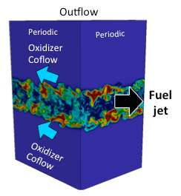
Use case: DNS of a turbulent jet flame
Di-methyl ether fuel stream in an oxidizer co-flow undergoing extinction and re-ignition stages

Slide 4
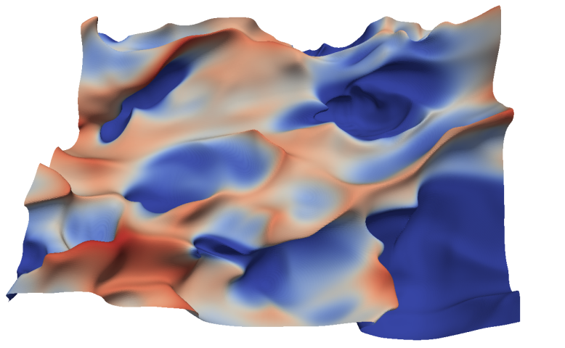
Use case: DNS of a turbulent jet flame
Flame is an iso-surface of mixture fraction – the ratio of unburnt fuel versus combustion products
OH concentration, classifies the flame into burning regions (red) and extinction holes (blue)
Tracking extinction holes over time
Notes:
As the simulation proceeds, more extinction holes develop, grow, and ultimately heal again and disappear.
Tracking this process over time on a per-hole basis may lead to new insights into why these holes are forming and what effects contribute to their closing.

Slide 5
Use case: DNS of a turbulent jet flame
Challenges:
  Flame evolves discontinuously due to low temporal resolution
    A repeated analysis is not feasible
    Complex fast moving geometry
    No common domain for tracking
    Temporal interpolation artifacts
  Extinction threshold is uncertain and unstable
    Exploring how evolution differs for different thresholds
    Parameter instabilities in the tracking
    Complex and convoluted tracking graphs
Notes:
A repeated analysis is practically infeasible due to the size of the source data ( ~1.5TB in total)
Spatial overlap does not apply as the flame surface itself moves quite significantly and flame surfaces of successive time steps rarely overlap.
Predictor-based schemes unreliable and difficult to tune for this case since flame surfaces become highly convoluted especially in later time steps, and features are quite densely present throughout the flame.
Tracking graphs are large, highly complex due to artifacts from the lack of temporal resolution and unavoidable instabilities in the parameter choices.

Slide 6
Contributions
Parameter-independent approach for tracking features embedded in time-dependent surfaces
Approach to remove artifacts caused by temporal undersampling in tracking graphs
A progressive, three-pass algorithm to produce temporally cohesive graphs
A system to explore temporal evolution of features with applications to several large-scale combustion simulations

Slide 7
Related work
Feature extraction
  Iso-surfaces, interval volumes
  Topology-based techniques: Morse-Smale complex, contour trees, merge trees
  Our work uses: Merge trees with localized thresholds
Feature correlation
  Spatial overlap, predictor-based approaches
  “Feature tracking using reeb graphs” - Weber et al.
  Our work uses: Simpler, flexible approach using merge trees and space-time iso-volumes
Data visualization
  Animation, morphing, story telling, time series plots, tracking graphs
  Our work uses: Tracking graphs with flexibility to simplify the graph
Notes:
Feature Extraction: We are interested in threshold-based features of a scalar field. We also want to be able to extract information for a large range of thresholds in a single pass
Feature Correlation: Weber et al. track embedded features – in their case fuel consumption restricted to a temperature isosurface – by first extracting a space-time isovolume and then thresholding it to extract a space-time isosurface. The Reeb graph of time as a function on this surface creates the tracking graph. However, this approach is quite involved and also does not allow the fuel consumption rate to vary.

Slide 8
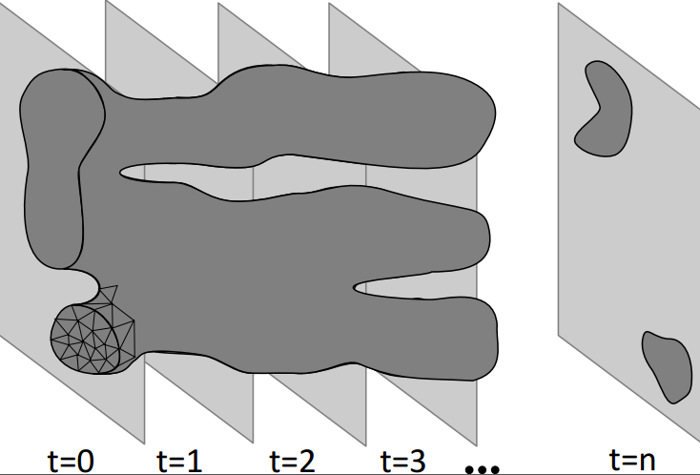
Background: Space-time iso-volumes
Region of space (and time) swept by a moving iso-surface
Linear interpolation in time and marching hypercubes algorithm of Bhaniramka et al.
    P. Bhaniramka, R. Wenger, and R. Crawfis. Isosurface construction in any dimension using convex hulls. IEEE Trans. Vis. Comp. Graph., 10(2):130–141, Mar 2004.
Tetrahedral mesh with three spatial and one time coordinate
Notes:
- To correlate the mixture fraction isosurfaces over time we assume a piecewise linear interpolation in time and use the algorithm of Bhaniramka et al. to compute a space-time isovolume.

Slide 9
Background: Merge trees
Encodes the hierarchical clustering of features for a wide range of parameters
Function
Value
y
z
x
Terrain Merge tree

Slide 10
Background: Merge trees
Encodes the hierarchical clustering of features for a wide range of parameters
Function
Value
y
z
x
Terrain Merge tree

Slide 11
Background: Merge trees
Encodes the hierarchical clustering of features for a wide range of parameters
Function
Value
y
z
x
Terrain Merge tree

Slide 12
Background: Merge trees
Encodes the hierarchical clustering of features for a wide range of parameters
Function
Value
y
z
x
Terrain Merge tree

Slide 13
Background: Merge trees
Extract features for a particular value by cutting the tree
  Cut at a fixed threshold
f₁
Function
Value
y
z
x
Terrain Merge tree

Slide 14
Background: Merge trees
Extract features for a particular value by cutting the tree
  Cut at a fixed threshold
  Arbitrary cut with localized thresholds
f₁
Function
Value
y
z
x
Terrain Merge tree

Slide 15
Correlating embedded features
Spatial overlap tracking does not apply directly
Compute explicit space-time iso-volume of mixture fraction between two consecutive time steps
Interpolate the corresponding OH values at all its vertices
Mesh defines the evolution of the extinction regions

Slide 16
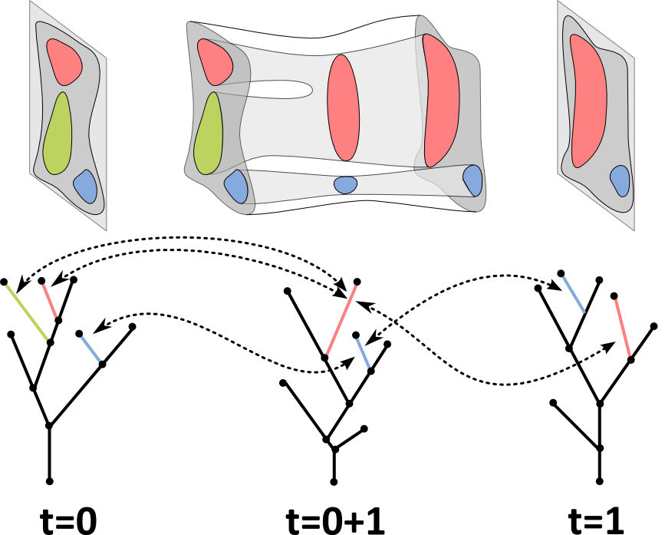
Correlating embedded features
Use overlap tracking on the three time steps
Iso-surface
Merge tree
Function
Value
Notes:
We extract the isosurfaces within each time step and extract their merge trees.
Then, we compute an additional merge tree of OH on the isovolume.
This merge tree by design encodes the nesting and segmentation of all super-contours of OH.
The mesh for the isovolume contains all the vertices of two consecutive time steps as well as an arbitrary number of additional vertices to form the connections.
So, now we can apply spatial overlap on the three time steps.
We track all features in t = 0 forward and all features in t = 1 backward to an intermediate representation t = 0 + 1.
Combined these provide the complete tracking information between both time steps.
For each two time steps, three merge trees are computed, the complete one and the two restricted to the starting and ending time steps, then overlap tracking is used for computing the relevant tracking results.

Slide 17
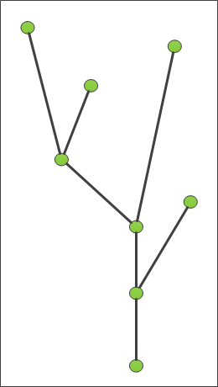
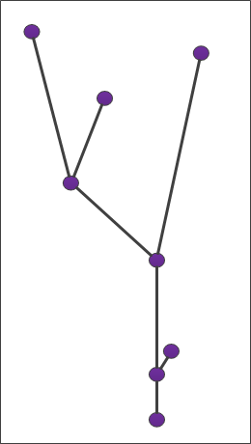
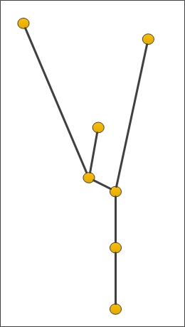
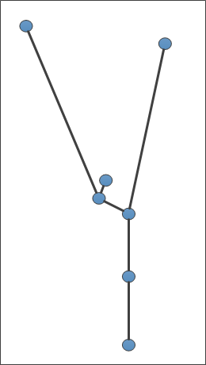
Generating tracking graphs
Features and their correlation details for each time step
f₂
Function
Value
t=0 t=0+1 t=1 t=1+2 … … …

Slide 18
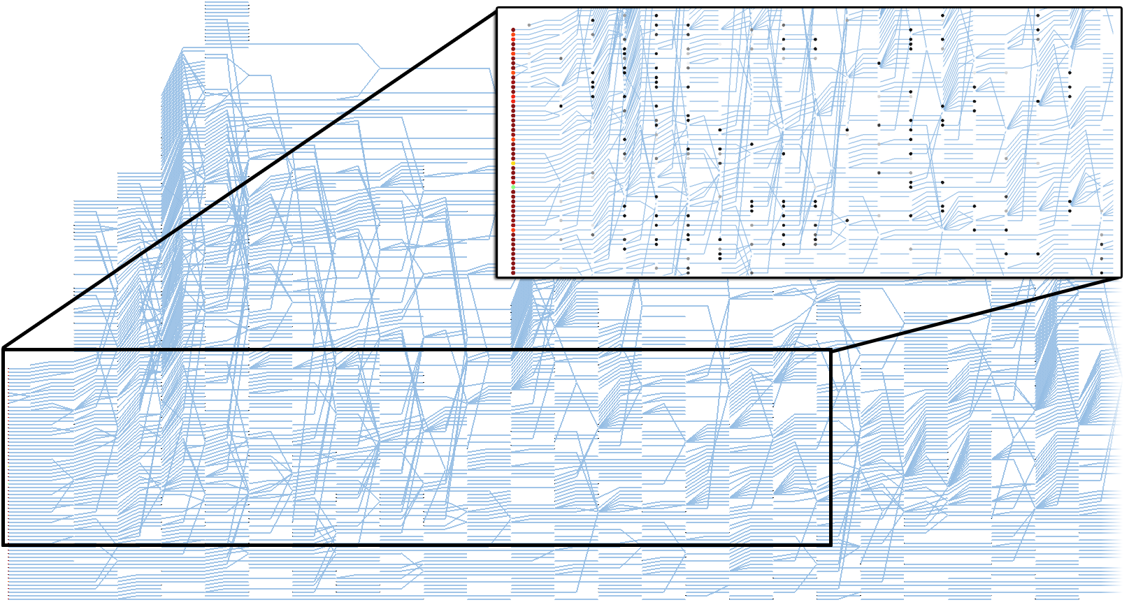
Resulting graphs large & highly complex
Artifacts caused by…
- Temporal undersampling
- Parameter instabilities
Turbulent jet flame data set
- First 26 of 101 time steps
- Total of 51 time steps with the intermediate time steps
- Only 1802 nodes

Slide 19
Temporal artifact reduction
Due to low temporal resolution of source data
Solutions:
  Repeat the Simulation
  In-situ tracking
  Alleviate artifacts using localized thresholds
  (too costly to consider in practice)
  (too costly , keeping two time steps in memory)

Slide 20
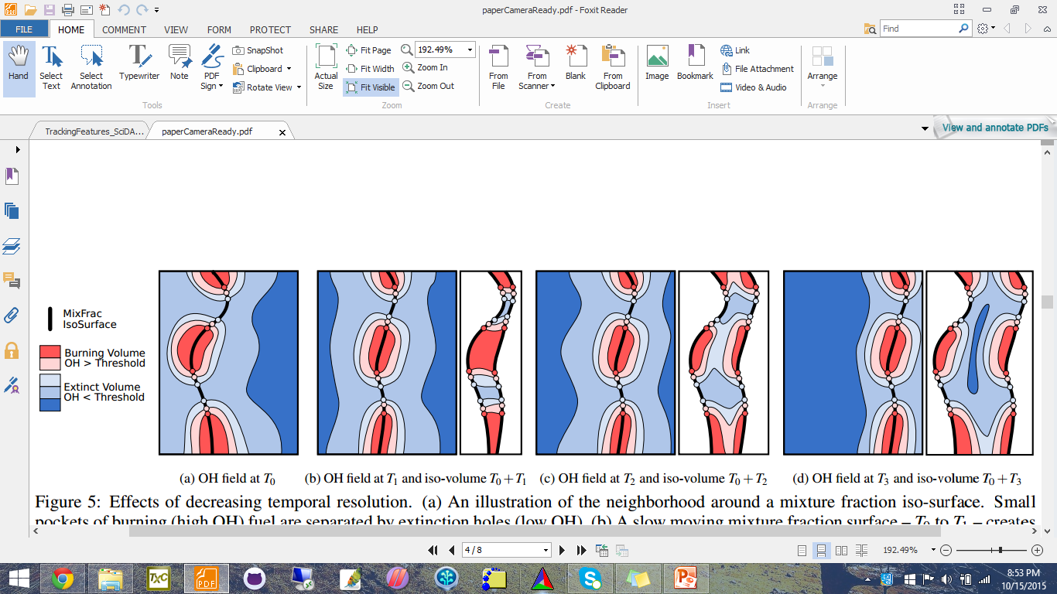
Temporal artifact reduction
Temporal artifacts

Slide 21
Temporal artifact reduction
Identify the nodes causing the temporal artifacts…
high valence, merge-split nodes in intermediate time steps
Lower their threshold value
Separate the extinction holes across time and result in the correct tracking information
OH
concentration
f₁

Slide 22
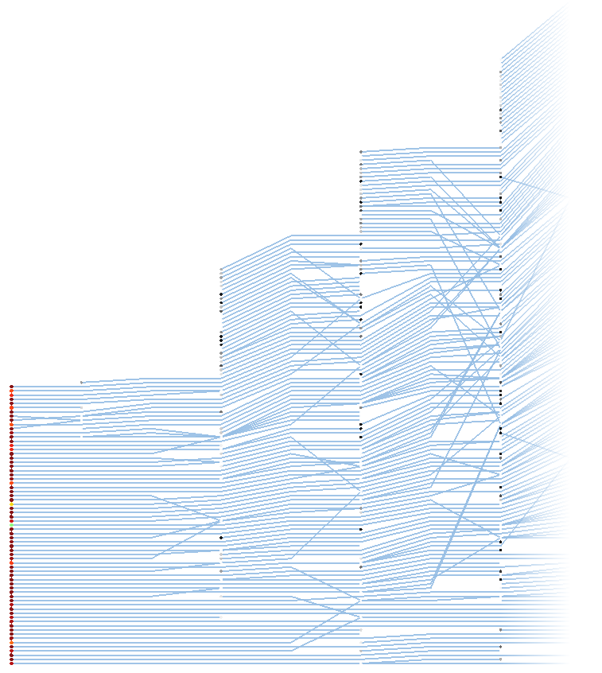
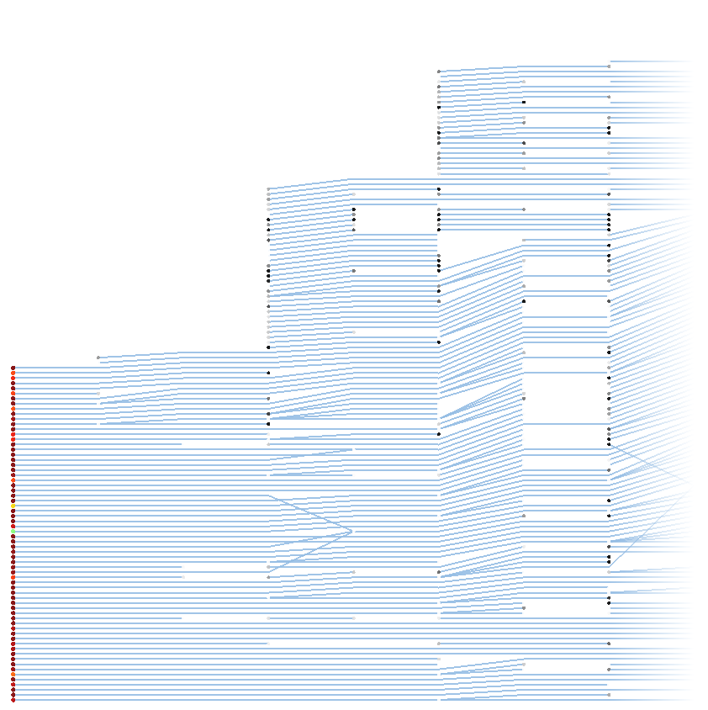
Temporal artifact reduction
Results: Turbulent jet flame dataset – smaller graph
Before After

Slide 23
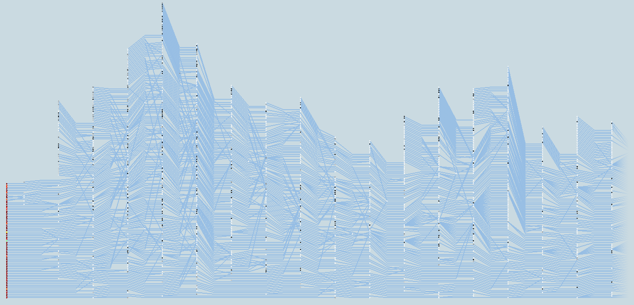
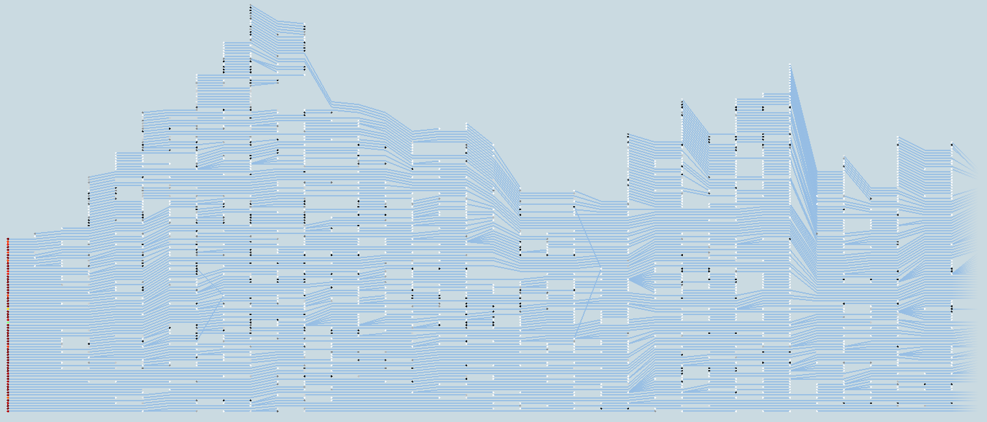
Temporal artifact reduction
Results: Turbulent jet flame dataset – longer graph
Before After

Slide 24
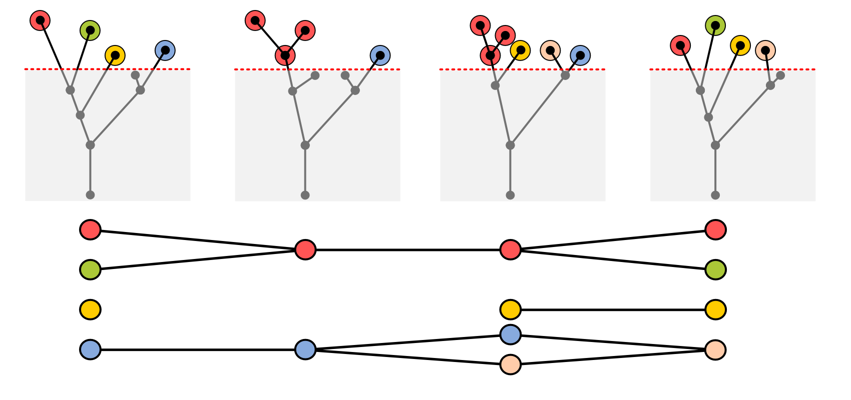
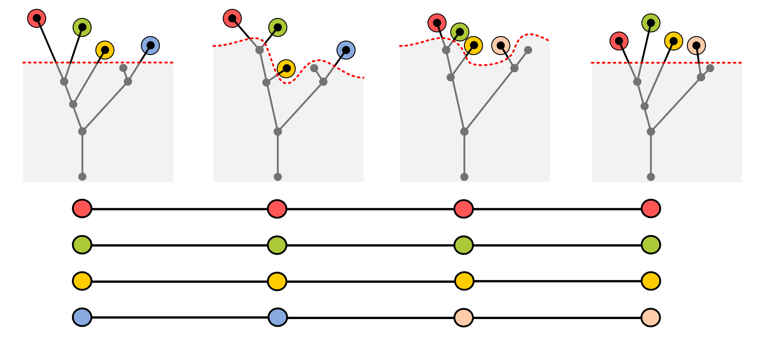
Tracking graph simplification
Due to parameter instabilities
Features hover right at the threshold, causing repeated merges and splits in the tracking graph
Function
Value

Slide 25
Tracking graph simplification
Use localized thresholds within a given error bound
Reduce the total number of non-valence two nodes
Produce temporally cohesive graphs
Computing the optimal graph with the least number of non-valence two nodes within a threshold range is NP-hard.

Slide 26
Tracking graph simplification
Progressive three-pass algorithm with a greedy heuristic:
left-to-right, right-to-left, and a final left-to-right pass
First two passes: greedily adjust each non-valence two node
Third pass: move unresolved events back to original location

Slide 27
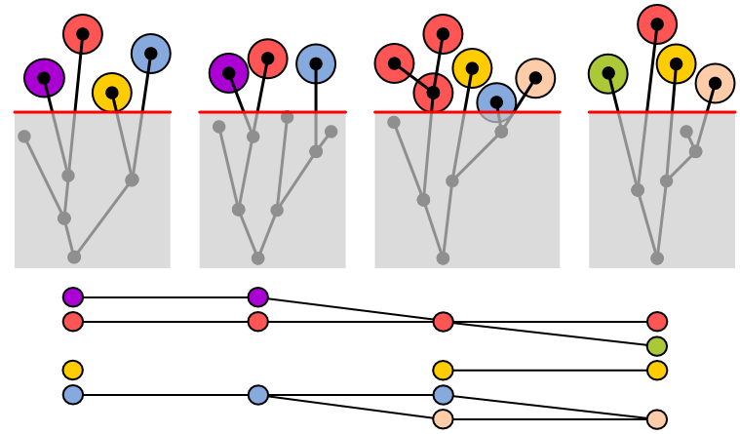
Original graph

Slide 28
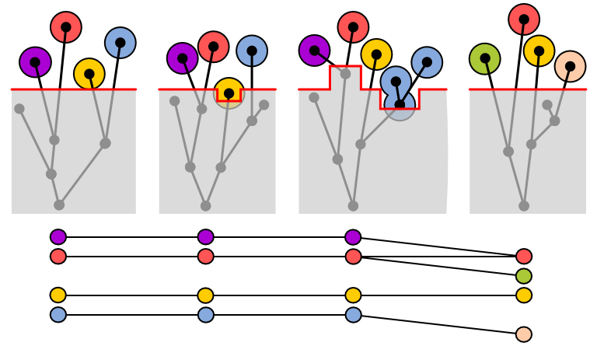
First pass: left-to-right

Slide 29
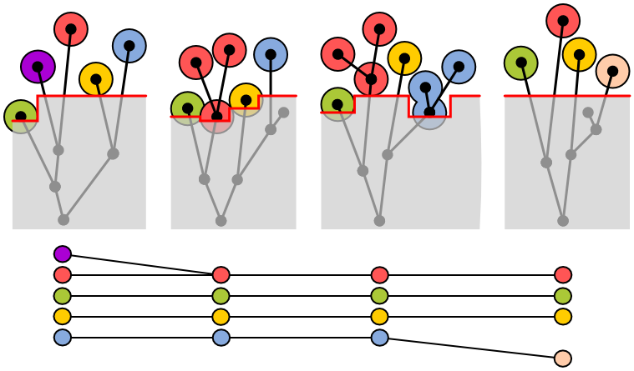
Second pass: right-to-left

Slide 30
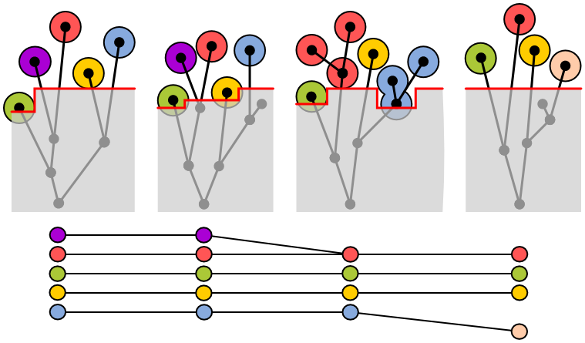
Third pass: left-to-right

Slide 31
Result

Slide 32
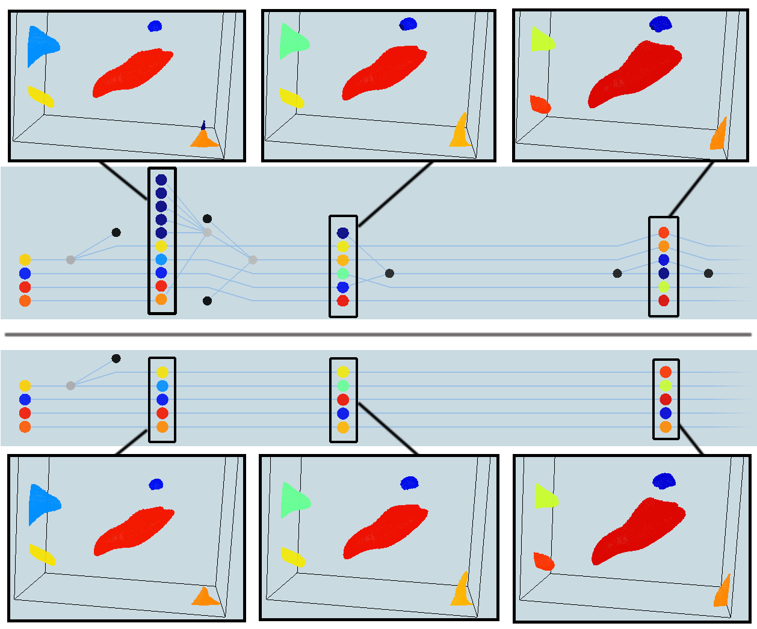
Tracking graph simplification
Results : Turbulent premixed counter flow dataset
Before
After

Slide 33
Datasets
Turbulent jet flame dataset
  101 time steps (1.5TB of data)
  Resolution 920 X 1400 X 720
Turbulent premixed counter flow dataset
  1048 time steps (2.7TB of data)
  Resolution 432 X 640 X 640
Idealized premixed hydrogen flame dataset
  100 time steps (400GB of data)
  Resolution 256 X 256 X 768
Synthetic data (verification purposes)

Slide 34
Insights gained
Temporal undersampling within simulation data
Better extinction threshold values
Use of tracking graphs in analyzing the growth of features over various conditions

Slide 35
Limitations
Results from using localized threshold remains limited by the feature definition of the merge tree
Only remove temporal artifacts where the artificial features in the in-between time are weaker
Greedy nature of the three-pass layout algorithm does not guarantee optimal graphs

Slide 36
Limitations
Results from using localized thresholds remains limited by the feature definition of the merge tree
Only remove temporal artifacts where the artificial features in the in-between time are weaker
Greedy nature of the three-pass layout algorithm does not guarantee optimal graphs

Slide 37
Summery
Novel algorithm for tracking embedded features
Tracking graphs to contain localized thresholds to enable removal of artifacts
  Artifacts due to temporal undersampling
  Artifacts due to parameter instabilities
Applications to several large-scale combustion simulations

Slide 38

Tracking Features in Embedded Surfaces:
Understanding Extinction in Turbulent Combustion
Wathsala Widanagamaachchi, Pavol Klacansky, Hemanth Kolla,
Ankit Bhagatwala, Jackie Chen, Valerio Pascucci and Peer-Timo Bremer.
Email:
wathsy@sci.utah.edu
klacansky@sci.utah.edu
Notes:
Why compute one intermediate timestep? Why not have multiple timesteps as opposed to the additional modification method? What is the cost for doing that against the other?
Why not do in-situ and try to do this in in-situ at this point of time?
Was the graphs helpful to the scientists?
Can you predict where you need additional timesteps?

Slide 39
Extra

Slide 40
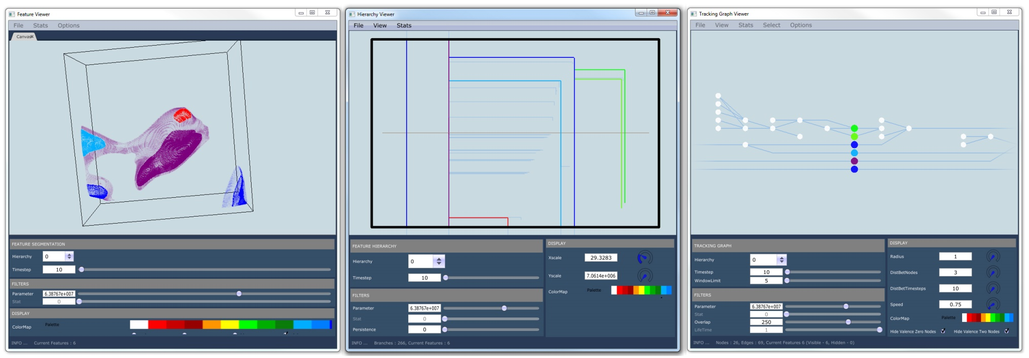
Tracking graph simplification
Extra
Selection of flexible feature definition parameters in tracking graphs
Intuitive rendering of the range of outcomes
Turbulent premixed counter flow dataset

Slide 41
Extra

Slide 42
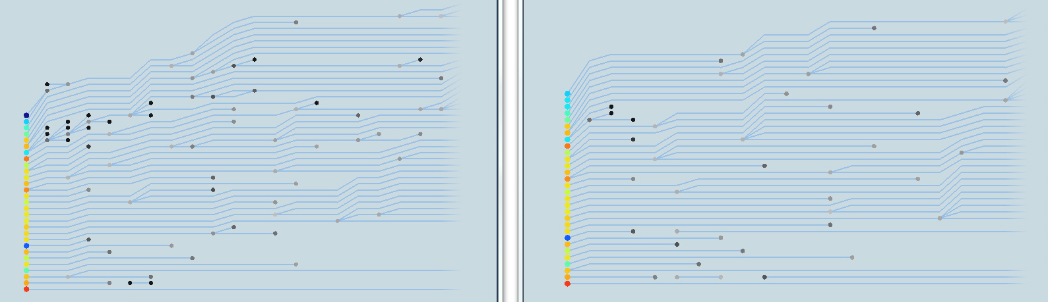
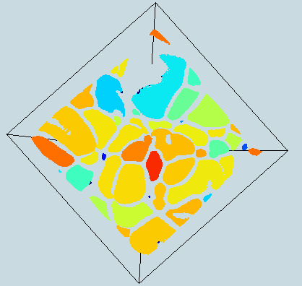
Tracking graph simplification
Extra
Results : Idealized premixed hydrogen flame dataset
Before After

