Slide 1
Lecture: Pipelining Extensions
Topics: bypassing, deeper pipelines, control hazards

Slide 2
RISC/CISC Loads/Stores
Registers and memory
Complex and reduced instrs
Format of a load/store

Slide 3
Pipeline Summary
RR ALU DM RW
ADD R3 ← R1, R2 Rd R1,R2 R1+R2 -- Wr R3
BEZ R1, [R5] Rd R1, R5 -- -- --
Compare, Set PC
LD R6 ← 8[R3] Rd R3 R3+8 Get data Wr R6
ST R6 → 8[R3] Rd R3,R6 R3+8 Wr data --

Slide 4
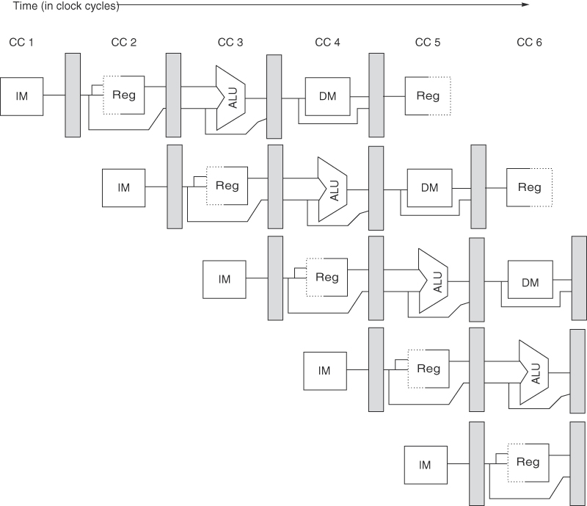
Problem 4
For the following code sequence, show how the instrs
flow through the pipeline:
ADD R3 ← R1, R2
LD R7 ← 8[R6]
ST R9 → 4[R8]
BEZ R4, [R5]

Slide 5
Problem 4
For the following code sequence, show how the instrs
flow through the pipeline:
ADD R3 ← R1, R2
LD R7 ← 8[R6]
ST R9 → 4[R8]
BEZ R4, [R5]
ADD
ADD
ADD
ADD
ADD
LD
LD
LD
LD
LD
ST
ST
ST
ST
BEZ
BEZ

Slide 6
Hazards
Structural hazards: different instructions in different stages
(or the same stage) conflicting for the same resource
Data hazards: an instruction cannot continue because it
needs a value that has not yet been generated by an
earlier instruction
Control hazard: fetch cannot continue because it does
not know the outcome of an earlier branch – special case
of a data hazard – separate category because they are
treated in different ways

Slide 7
Structural Hazards
Example: a unified instruction and data cache →
stage 4 (MEM) and stage 1 (IF) can never coincide
The later instruction and all its successors are delayed
until a cycle is found when the resource is free → these
are pipeline bubbles
Structural hazards are easy to eliminate – increase the
number of resources (for example, implement a separate
instruction and data cache)

Slide 8
Problem 5
Show the instruction occupying each stage in each cycle (no bypassing)
if I1 is R1+R2→R3 and I2 is R3+R4→R5 and I3 is R7+R8→R9
CYC-1
CYC-2
CYC-3
CYC-4
CYC-5
CYC-6
CYC-7
CYC-8
IF
IF
IF
IF
IF
IF
IF
IF
D/R
D/R
D/R
D/R
D/R
D/R
D/R
D/R
ALU
ALU
ALU
ALU
ALU
ALU
ALU
ALU
DM
DM
DM
DM
DM
DM
DM
DM
RW
RW
RW
RW
RW
RW
RW
RW

Slide 9
Problem 5
Show the instruction occupying each stage in each cycle (no bypassing)
if I1 is R1+R2→R3 and I2 is R3+R4→R5 and I3 is R7+R8→R9
CYC-1
CYC-2
CYC-3
CYC-4
CYC-5
CYC-6
CYC-7
CYC-8
IF
I1
IF
I2
IF
I3
IF
I3
IF
I3
IF
I4
IF
I5
IF
D/R
D/R
I1
D/R
I2
D/R
I2
D/R
I2
D/R
I3
D/R
I4
D/R
ALU
ALU
ALU
I1
ALU
ALU
ALU
I2
ALU
I3
ALU
DM
DM
DM
DM
I1
DM
DM
DM
I2
DM
I3
RW
RW
RW
RW
RW
I1
RW
RW
RW
I2

Slide 10
Bypassing: 5-Stage Pipeline
PC/L1
L2
L3
L4
L5
Source: H&P textbook

Slide 11
Problem 6
Show the instruction occupying each stage in each cycle (with bypassing)
if I1 is R1+R2→R3 and I2 is R3+R4→R5 and I3 is R3+R8→R9.
Identify the input latch for each input operand.
CYC-1
CYC-2
CYC-3
CYC-4
CYC-5
CYC-6
CYC-7
CYC-8
IF
IF
IF
IF
IF
IF
IF
IF
D/R
D/R
D/R
D/R
D/R
D/R
D/R
D/R
ALU
ALU
ALU
ALU
ALU
ALU
ALU
ALU
DM
DM
DM
DM
DM
DM
DM
DM
RW
RW
RW
RW
RW
RW
RW
RW

Slide 12
Problem 6
Show the instruction occupying each stage in each cycle (with bypassing)
if I1 is R1+R2→R3 and I2 is R3+R4→R5 and I3 is R3+R8→R9.
Identify the input latch for each input operand.
CYC-1
CYC-2
CYC-3
CYC-4
CYC-5
CYC-6
CYC-7
CYC-8
IF
I1
IF
I2
IF
I3
IF
I4
IF
I5
IF
IF
IF
D/R
D/R
I1
D/R
I2
D/R
I3
D/R
I4
D/R
D/R
D/R
L3 L3 L4 L3 L5 L3
ALU
ALU
ALU
I1
ALU
I2
ALU
I3
ALU
ALU
ALU
DM
DM
DM
DM
I1
DM
I2
DM
I3
DM
DM
RW
RW
RW
RW
RW
I1
RW
I2
RW
I3
RW

Slide 13
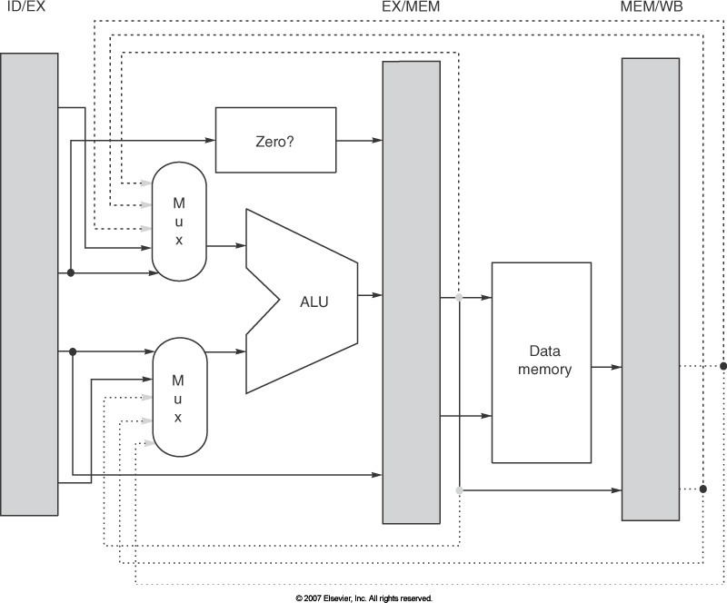
Pipeline Implementation
Signals for the muxes have to be generated – some of this can happen during ID
Need look-up tables in decode stage to identify situations that merit bypassing/stalling
– the number of inputs to the muxes goes up

Slide 14
Problem 7
For the 5-stage pipeline (RR and RW take half a cycle)
For the following pairs of instructions, how many stalls will the 2nd
instruction experience (with and without bypassing)?
ADD R3 ← R1+R2
ADD R5 ← R3+R4
LD R2 ← [R1]
ADD R4 ← R2+R3
LD R2 ← [R1]
SD R3 → [R2]
LD R2 ← [R1]
SD R2 → [R3]
IF
D/RR
AL
DM
RW

Slide 15
Problem 7
For the 5-stage pipeline (RR and RW take half a cycle)
For the following pairs of instructions, how many stalls will the 2nd
instruction experience (with and without bypassing)?
ADD R3 ← R1+R2
ADD R5 ← R3+R4 without: 2 with: 0
LD R2 ← [R1]
ADD R4 ← R2+R3 without: 2 with: 1
LD R2 ← [R1]
SD R3 → [R2] without: 2 with: 1
LD R2 ← [R1]
SD R2 → [R3] without: 2 with: 0
IF
D/RR
AL
DM
RW

Slide 16
Summary
For the 5-stage pipeline, bypassing can eliminate delays
between the following example pairs of instructions:
add/sub R1, R2, R3
add/sub/lw/sw R4, R1, R5
lw R1, 8(R2)
sw R1, 4(R3)
The following pairs of instructions will have intermediate
stalls:
lw R1, 8(R2)
add/sub/lw R3, R1, R4 or sw R3, 8(R1)
fmul F1, F2, F3
fadd F5, F1, F4

