Slide 1
Lecture: Pipelining Hazards
Topics: structural and data hazards
HW2 posted later today; due in a week

Slide 2
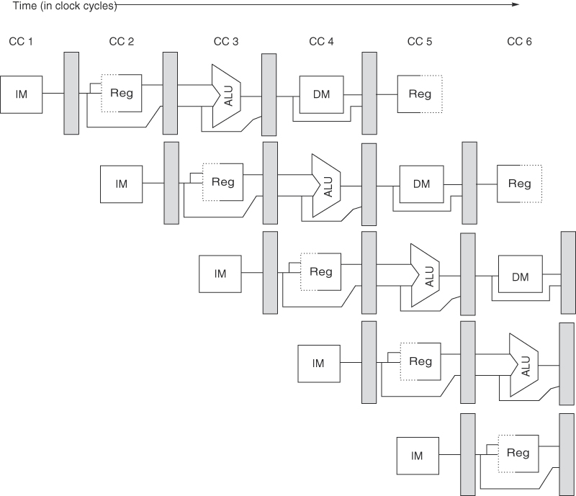
A 5-Stage Pipeline
Source: H&P textbook

Slide 3
A 5-Stage Pipeline
Use the PC to access the I-cache and increment PC by 4

Slide 4
A 5-Stage Pipeline
Read registers, compare registers, compute branch target; for now, assume
branches take 2 cyc (there is enough work that branches can easily take more)

Slide 5
A 5-Stage Pipeline
ALU computation, effective address computation for load/store

Slide 6
A 5-Stage Pipeline
Memory access to/from data cache, stores finish in 4 cycles

Slide 7
A 5-Stage Pipeline
Write result of ALU computation or load into register file

Slide 8
RISC/CISC Loads/Stores
Registers and memory
Complex and reduced instrs
Format of a load/store

Slide 9
Problem 3
Convert this C code into equivalent RISC assembly
instructions
a[i] = b[i] + c[i];

Slide 10
Problem 3
Convert this C code into equivalent RISC assembly
instructions
a[i] = b[i] + c[i];
LD R2, [R1] # R1 has the address for variable i
MUL R3, R2, 8 # the offset from the start of the array
ADD R7, R3, R4 # R4 has the address of a[0]
ADD R8, R3, R5 # R5 has the address of b[0]
ADD R9, R3, R6 # R6 has the address of c[0]
LD R10, [R8] # Bringing b[i]
LD R11, [R9] # Bringing c[i]
ADD R12, R11, R10 # Sum is in R12
ST R12, [R7] # Putting result in a[i]

Slide 11
Pipeline Summary
RR ALU DM RW
ADD R3 ← R1, R2 Rd R1,R2 R1+R2 -- Wr R3
BEZ R1, [R5] Rd R1, R5 -- -- --
Compare, Set PC
LD R6 ← 8[R3] Rd R3 R3+8 Get data Wr R6
ST R6 → 8[R3] Rd R3,R6 R3+8 Wr data --

Slide 12
Problem 4
For the following code sequence, show how the instrs
flow through the pipeline:
ADD R3 ← R1, R2
LD R7 ← 8[R6]
ST R9 → 4[R8]
BEZ R4, [R5]

Slide 13
Problem 4
For the following code sequence, show how the instrs
flow through the pipeline:
ADD R3 ← R1, R2
LD R7 ← 8[R6]
ST R9 → 4[R8]
BEZ R4, [R5]
ADD
ADD
ADD
ADD
ADD
LD
LD
LD
LD
LD
ST
ST
ST
ST
BEZ
BEZ

Slide 14
Hazards
Structural hazards: different instructions in different stages
(or the same stage) conflicting for the same resource
Data hazards: an instruction cannot continue because it
needs a value that has not yet been generated by an
earlier instruction
Control hazard: fetch cannot continue because it does
not know the outcome of an earlier branch – special case
of a data hazard – separate category because they are
treated in different ways

Slide 15
Structural Hazards
Example: a unified instruction and data cache →
stage 4 (MEM) and stage 1 (IF) can never coincide
The later instruction and all its successors are delayed
until a cycle is found when the resource is free → these
are pipeline bubbles
Structural hazards are easy to eliminate – increase the
number of resources (for example, implement a separate
instruction and data cache)

Slide 16
Problem 5
Show the instruction occupying each stage in each cycle (no bypassing)
if I1 is R1+R2→R3 and I2 is R3+R4→R5 and I3 is R7+R8→R9
CYC-1
CYC-2
CYC-3
CYC-4
CYC-5
CYC-6
CYC-7
CYC-8
IF
IF
IF
IF
IF
IF
IF
IF
D/R
D/R
D/R
D/R
D/R
D/R
D/R
D/R
ALU
ALU
ALU
ALU
ALU
ALU
ALU
ALU
DM
DM
DM
DM
DM
DM
DM
DM
RW
RW
RW
RW
RW
RW
RW
RW

Slide 17
Problem 5
Show the instruction occupying each stage in each cycle (no bypassing)
if I1 is R1+R2→R3 and I2 is R3+R4→R5 and I3 is R7+R8→R9
CYC-1
CYC-2
CYC-3
CYC-4
CYC-5
CYC-6
CYC-7
CYC-8
IF
I1
IF
I2
IF
I3
IF
I3
IF
I3
IF
I4
IF
I5
IF
D/R
D/R
I1
D/R
I2
D/R
I2
D/R
I2
D/R
I3
D/R
I4
D/R
ALU
ALU
ALU
I1
ALU
ALU
ALU
I2
ALU
I3
ALU
DM
DM
DM
DM
I1
DM
DM
DM
I2
DM
I3
RW
RW
RW
RW
RW
I1
RW
RW
RW
I2

Slide 18
Bypassing: 5-Stage Pipeline
Source: H&P textbook

Slide 19
Problem 6
Show the instruction occupying each stage in each cycle (with bypassing)
if I1 is R1+R2→R3 and I2 is R3+R4→R5 and I3 is R3+R8→R9.
Identify the input latch for each input operand.
CYC-1
CYC-2
CYC-3
CYC-4
CYC-5
CYC-6
CYC-7
CYC-8
IF
IF
IF
IF
IF
IF
IF
IF
D/R
D/R
D/R
D/R
D/R
D/R
D/R
D/R
ALU
ALU
ALU
ALU
ALU
ALU
ALU
ALU
DM
DM
DM
DM
DM
DM
DM
DM
RW
RW
RW
RW
RW
RW
RW
RW

Slide 20
Problem 6
Show the instruction occupying each stage in each cycle (with bypassing)
if I1 is R1+R2→R3 and I2 is R3+R4→R5 and I3 is R3+R8→R9.
Identify the input latch for each input operand.
CYC-1
CYC-2
CYC-3
CYC-4
CYC-5
CYC-6
CYC-7
CYC-8
IF
I1
IF
I2
IF
I3
IF
I4
IF
I5
IF
IF
IF
D/R
D/R
I1
D/R
I2
D/R
I3
D/R
I4
D/R
D/R
D/R
L3 L3 L4 L3 L5 L3
ALU
ALU
ALU
I1
ALU
I2
ALU
I3
ALU
ALU
ALU
DM
DM
DM
DM
I1
DM
I2
DM
I3
DM
DM
RW
RW
RW
RW
RW
I1
RW
I2
RW
I3
RW

