Slide 1
CS/EE 6810: Computer Architecture
Fall 2022
Rajeev Balasubramonian
Mon/Wed 1:25pm - 2:45pm

Slide 2
CS/EE 6810: Computer Architecture
Background: CS 3810 or equivalent, based on Hennessy
and Patterson’s Computer Organization and Design
Text for CS/EE 6810: Hennessy and Patterson’s
Computer Architecture, A Quantitative Approach,
5th or 6th Edition
Topics
Measuring performance/cost/power
Instruction level parallelism, dynamic and static
Memory hierarchy
Multiprocessors
Accelerators, security
Storage systems and networks

Slide 3
Lectures and Office Hours
Class format:
Most lectures pre-recorded and posted on YouTube
Regular lectures every Mon/Wed
Allocate time every week to do video review, perhaps as
you’re working on that week’s assignment
Masks, vaccines strongly encouraged; inform me in case
of a positive covid test; stay home if you’re unwell
Office hours mentioned on class webpage; also
available for a few minutes right after every lecture;
email me to set up any other meetings
TA office hours – TBA – Tues, Wed, Thurs

Slide 4
Organizational Issues
Canvas for hw submissions, announcements, grades.
Assignment almost every week (due Wed/Thu).
Special accommodations, add/drop policies, preferred
names/pronouns
Class web-page, slides, notes, and videos at
https://www.cs.utah.edu/~rajeev/cs6810

Slide 5
Grading
Midterm (30%), Final exam (30%), Homeworks (40%)
We will drop your two lowest homework scores
No tolerance for cheating

Slide 6
Lecture 1: Computing Trends, Metrics
Topics:
Technology trends
Metrics (performance, energy, reliability)

Slide 7
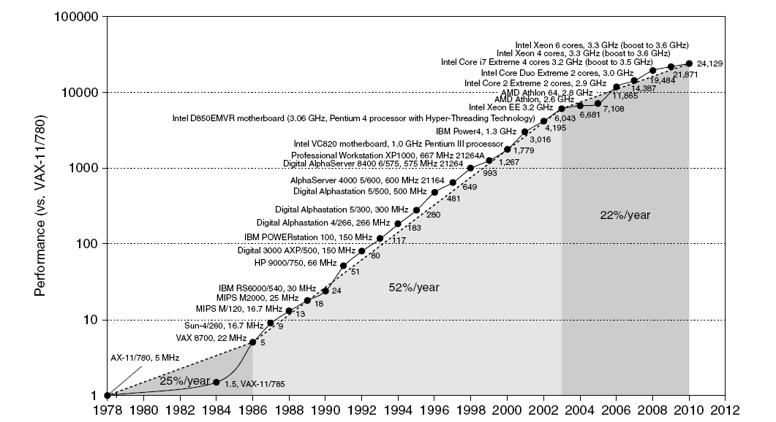
Historical Microprocessor Performance
Source: H&P textbook

Slide 8
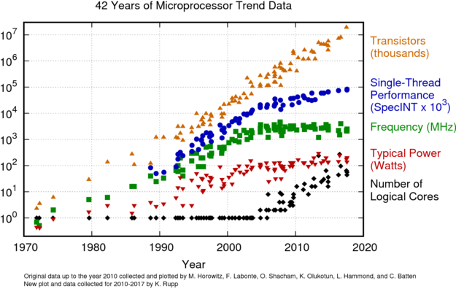
Microprocessor Performance
Source: karlrupp.net

Slide 9
Processor Technology Trends
Transistor density increases by 35% per year and die size
increases by 10-20% per year… more functionality
Transistor speed improves linearly with size (complex
equation involving voltages, resistances, capacitances)
Wire delays do not scale down at the same rate as logic delays
The power wall: it is not possible to consistently run at
higher frequencies without hitting power/thermal limits;
fancy cooling required beyond ~150W

Slide 10
What Helps Performance?
In a clock cycle, can do more work -- since transistors are
faster, transistors are more energy-efficient, and there’s
more of them
Better architectures: finding more parallelism in one thread,
better branch prediction, better cache policies, better
memory organizations, more thread-level parallelism,
moving computations to memory, accelerating some kernels, …

Slide 11
Points to Note
The 52% growth per year is because of faster clock speeds
and architectural innovations (led to 25x higher speed)
Clock speed increases have dropped to 1% per year in
recent years
The 22% growth includes the parallelization from multiple
cores
Moore’s Law: transistors on a chip double every 18-24 months

Slide 12
Power Impact
Dynamic Power proportional to activity x C x V² x f
Power wall: fancy cooling required beyond ~150W
Increasing frequency led to power wall in early 2000s
Frequency has stagnated since then
End of voltage (Dennard) scaling in early 2010s
Has led to dark silicon and dim silicon (occasional turbo)

Slide 13
Performance Stagnation
Running out of ideas to improve single thread performance
Power wall makes it harder to add complex features
Power wall makes it harder to increase frequency
Transistor count will stagnate shortly
Additional performance provided by: more cores, occasional
spikes in frequency, accelerators

Slide 14
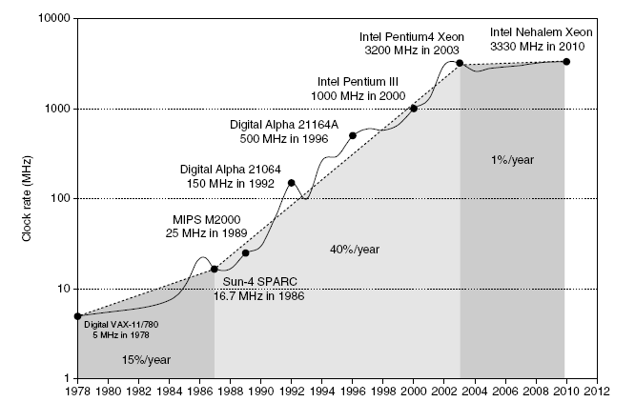
Clock Speed Increases
Source: H&P textbook

Slide 15
Recent Microprocessor Trends
Transistors: 1.43x / year
Cores: 1.2 - 1.4x
Performance: 1.15x
Frequency: 1.05x
Power: 1.04x
2004
2010
Source: Micron University Symp.

Slide 16
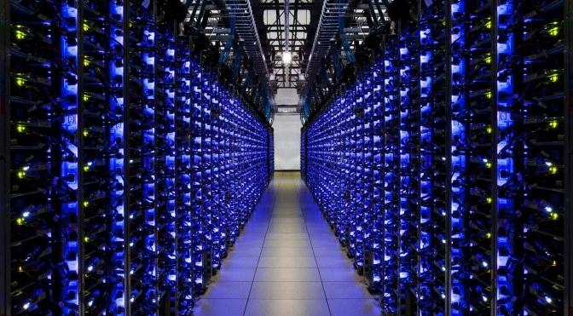
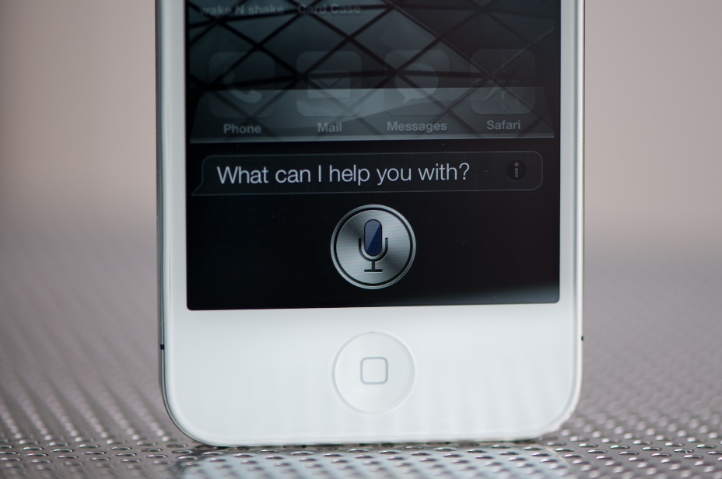
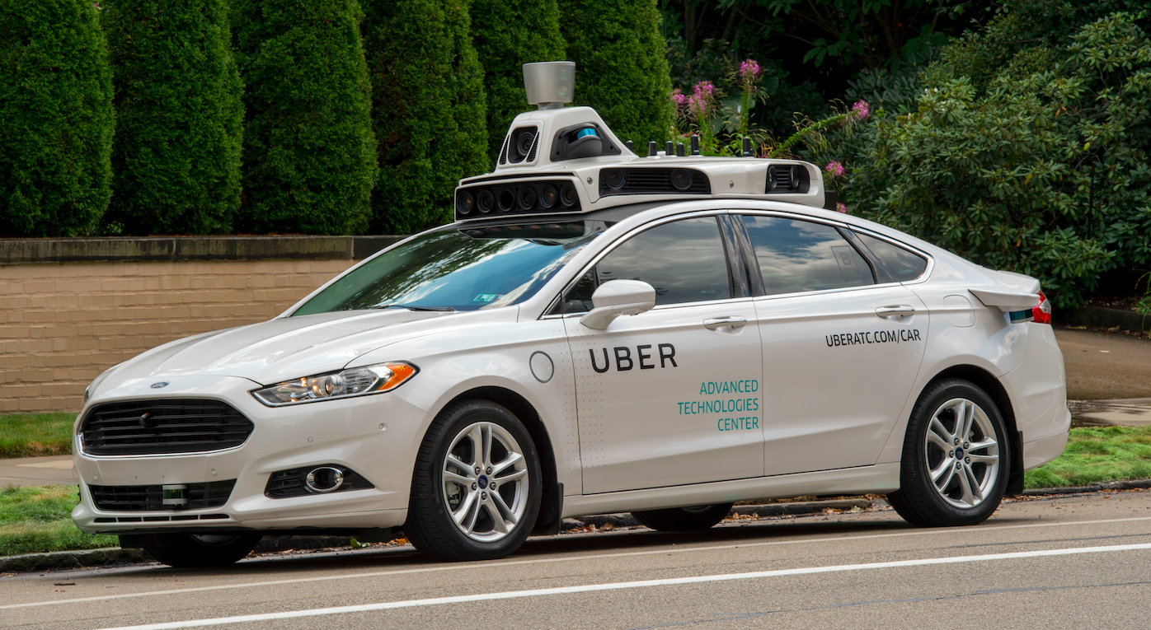
More Diverse Platforms
Image credits: uber, extremetech, anandtech

Slide 17
New Design Concerns
Image credits: gizmodo

Slide 18
Where Are We Headed?
Modern trends:
Clock speed improvements are slowing (power constraints)
Difficult to further optimize a single core for performance
Multi-cores: each new processor generation will
accommodate more cores
Need better programming models and efficient
execution for multi-threaded applications
Need better memory hierarchies
Need greater energy efficiency
Dark silicon, accelerators
Reduced data movement
Emergence of new metrics: security, reliability
Emergence of new workloads: ML, graphs, genomics

