Slide 1
Algorithms for Subpath Convex Hull Queries and Ray-Shooting Among Segments
Haitao Wang
Utah State University
SoCG 2020

Slide 2
Subpath convex hull queries
Input: a simple path π = p₁, p₂, …, p_{n} of n vertices in the plane
Queries: given two vertices p_{i} and p_{j}, compute the convex hull of the subpath π(i,j) between them
The convex hull should be represented in a data structure to facilitate binary-search-based queries
p_{j}
p₁
p_{n}
p₂
p_{i}

Slide 3
Previous work and our result
Guibas, Hershberger, and Snoeyink, 1990:
O(n) space and O(log n loglog n) query time
O(n loglog n) space and O(log n) query time
O(n log*n) space and O(log n log* n) query time
O(n) preprocessing time after sorting all vertices of π by x-coordinate
a compact interval tree is returned for each query
support all binary-search-based queries on the convex hull in O(log n) time
the convex hull can be retrieved in time linear in the number of its vertices
Our result:
O(n) space and O(log n) query time
O(n) preprocessing time after sorting
a compact interval tree is returned for each query

Slide 4
Applications
Improvements on many other problems (space reduced by a factor of log log n):
Computing an optimal time-convex hull
Enclosing polygons by two minimum area rectangles
computing a guarding set for simple polygons in wireless location
L₁ top-k weighted sum aggregate nearest and farthest neighbor searching

Slide 5
Ray-shooting in the plane
Ray-shooting among lines
Input: a set of n lines in the plane
Queries: given a ray, find the first line hit by the ray
Intersection detection
Input: a set of (possibly intersecting) line segments
Queries: given a line, determine whether it intersects any segment
Ray-shooting among segments
Input: a set of (possibly intersecting) line segments
Queries: given a ray, find the first segment hit by the ray
Ray-shooting among non-intersecting segments

Slide 6
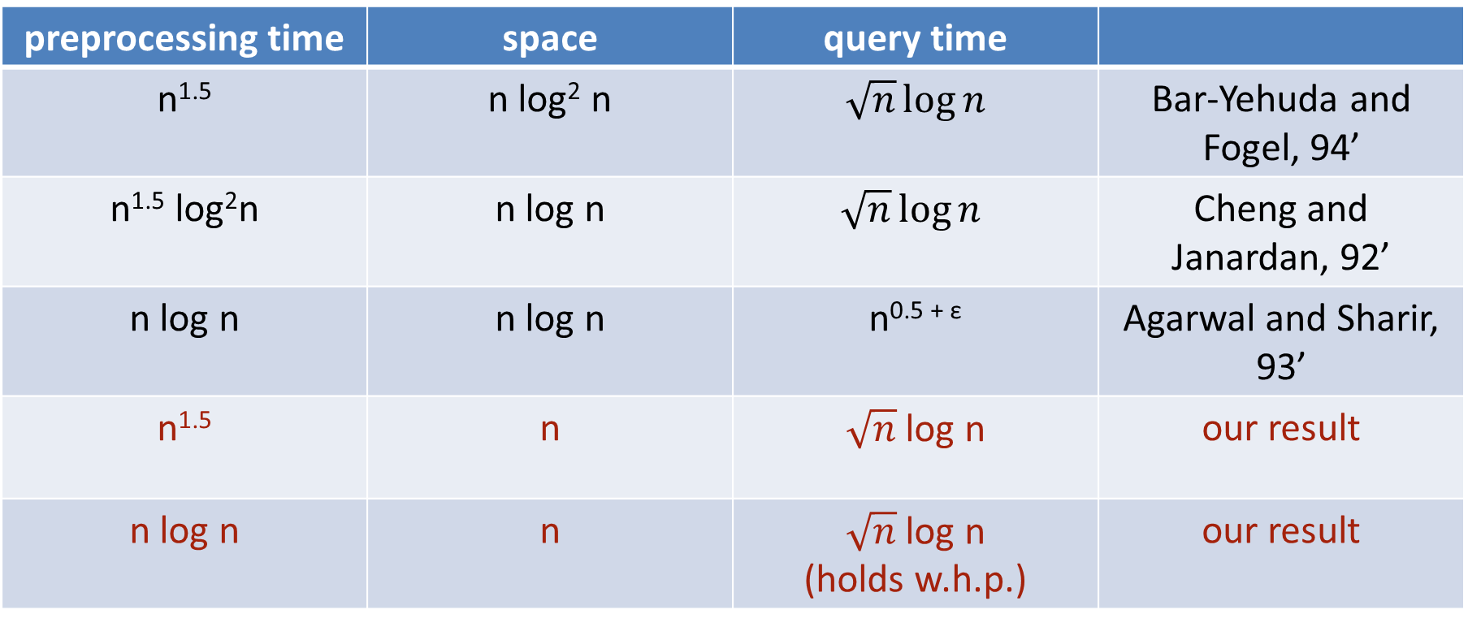
Results: ray-shooting among lines
preprocessing time | space | query time
n^{1.5} | n log² n | $$\sqrt{n}\log{n}$$ | Bar-Yehuda and Fogel, 94’
n^{1.5} log²n | n log n | $$\sqrt{n}\log{n}$$ | Cheng and Janardan, 92’
n log n | n log n | n^{0.5 + ε} | Agarwal and Sharir, 93’
n^{1.5} | n | $\sqrt{n}$ log n | our result
n log n | n | $\sqrt{n}$ log n (holds w.h.p.) | our result

Slide 7
Results: intersection detection
preprocessing time | space | query time
n^{1.5} log² n | n log n | $$\sqrt{n}\log{n}$$ | Cheng and Janardan, 92’
n^{1.5} | n | $\sqrt{n}$ log n | our result
n log n | n | $\sqrt{n}$ log n (holds w.h.p.) | our result

Slide 8
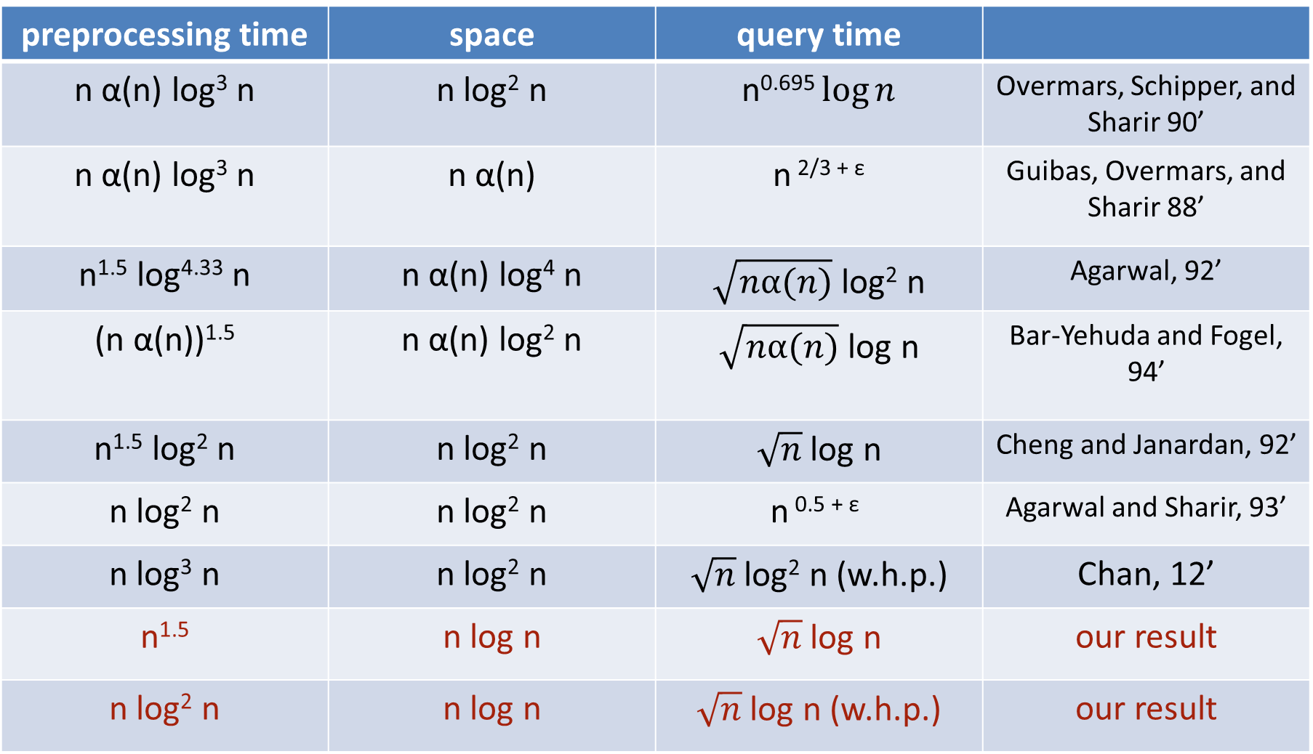
Results: ray-shooting among intersecting segments
preprocessing time | space | query time
n α(n) log³ n | n log² n | n^{0.695} $\log{n}$ | Overmars, Schipper, and Sharir 90’
n α(n) log³ n | n α(n) | $$\text{n} \text{2/3 }\text{+ }\text{ε}$$ | Guibas, Overmars, and Sharir 88’
n^{1.5} log^{4.33} n | n α(n) log⁴ n | $\sqrt{nα(n)}$ log² n | Agarwal, 92’
(n α(n))^{1.5} | n α(n) log² n | $\sqrt{nα(n)}$ log n | Bar-Yehuda and Fogel, 94’
n^{1.5} log² n | n log² n | $\sqrt{n}$ log n | Cheng and Janardan, 92’
n log² n | n log² n | $$\text{n} \text{0.5 }\text{+ }\text{ε}$$ | Agarwal and Sharir, 93’
n log³ n | n log² n | $\sqrt{n}$ log² n (w.h.p.) | Chan, 12’
n^{1.5} | n log n | $\sqrt{n}$ log n | our result
n log² n | n log n | $\sqrt{n}$ log n (w.h.p.) | our result

Slide 9
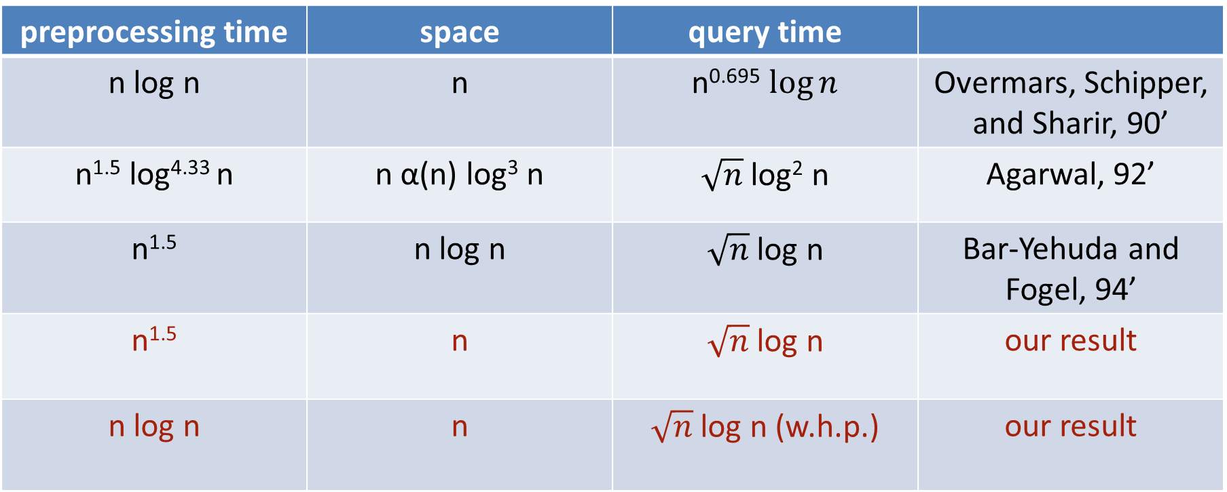
Results: ray-shooting among non-intersecting segments
preprocessing time | space | query time
n log n | n | n^{0.695} $\log{n}$ | Overmars, Schipper, and Sharir, 90’
n^{1.5} log^{4.33} n | n α(n) log³ n | $\sqrt{n}$ log² n | Agarwal, 92’
n^{1.5} | n log n | $\sqrt{n}$ log n | Bar-Yehuda and Fogel, 94’
n^{1.5} | n | $\sqrt{n}$ log n | our result
n log n | n | $\sqrt{n}$ log n (w.h.p.) | our result

Slide 10
Subpath convex hulls queries
Input: a simple path π = p₁, p₂, …, p_{n} of n vertices in the plane
Queries: given two vertices p_{i} and p_{j}, compute the convex hull of the subpath π(i,j) between them
Assume: all vertices of π have been sorted by x-coordinate
p_{j}
p₁
p_{n}
p₂
p_{i}

Slide 11
Interval trees to store convex hulls
Use an interval tree on all vertices of π to store the convex hull of π
upper hull and lower hull are stored separately
Each hull edge is stored at the highest node spanned by it
Issue: many empty nodes

Slide 12
Change the interval tree to a compact interval tree (CIT)
Remove empty nodes by relinking each non-empty node the child of its nearest non-empty ancestor
Size of the CIT is the linear in the number of hull edges

Slide 13
Two lemmas
T(π’): the CIT of any subpath π’ of π
Lemma 1 (GHS 90’): With O(n) time preprocessing, T(π’) for any subpath π’ of π can be computed in O(|π’|) time.
Lemma 2 (GHS 90’): Given T(π₁) and T(π₂) for two consecutive subpaths π₁ and π₂, T(π₁◦ π₂) can be computed in O(log n) time and O(log n) additional space by merging T(π₁) and T(π₂), without altering T(π₁) or T(π₂).

Slide 14
Preprocessing
Build a decomposition tree DT(π)
A complete binary tree whose leaves correspond to the vertices of π following their order in π
Remove those nodes whose subtrees have less than log² n leaves
Each leaf in the new tree DT(π) corresponds to a canonical subpath of log² n vertices
Each internal node v corresponds to a canonical subpath
DT(π) has O(n / log² n) nodes
Build a CIT for the canonical subpath of each leaf by Lemma 1
O(log² n) time for each leaf
O(n) time for all leaves
In a bottom-up manner, build a CIT for the canonical subpath of each internal node, by merging the CITs at their children, by Lemma 2
O(log n) time for each node
O(n) time for all O(n / log² n) nodes
Total preprocessing time/space: O(n)
a subpath of log² n vertices

Slide 15
A preliminary query algorithm of O(log² n) time
Consider two query vertices p_{i} and p_{j} of π
If p_{i} and p_{j} are from the same leaf,
the query subpath π(i,j) has at most log² n vertices
compute T(π(i,j)) directly by Lemma 1, in O(log² n) time
i
j

Slide 16
If p_{i} and p_{j} are not from the same leaf,
v: the leaf containing p_{i}
u: the leaf containing p_{j}
w: the lowest common ancestor of u and v
partition π(i,j) into two subpaths
one is contained in the left subtree of w
one is contained in the right subtree of w
compute the CITs for the two subpaths separately and then merge them by Lemma 2 in O(log n) time
Compute the CIT for left subpath π(i,k)
partition it into two subpaths
one contained in v
compute its CIT directly by Lemma 1
O(log² n) time
the other covered by the blue subtrees
merge the CITs for O(log n) canonical subpaths by Lemma 2
O(log² n) time
compute the CITs for the two subpaths separately and then merge them by Lemma 2 in O(log n) time
w
v
u
i
t
π(i,j)
j
k

Slide 17
Improve the query time to O(log n)
If p_{i} and p_{j} are from the same leaf,
the query subpath π(i,j) has at most log² n vertices
compute T(π(i,j)) directly by Lemma 1, in O(log² n) time
Improvement:
For the canonical subpath π_{v} at each leaf v, build its decomposition tree DT(π_{v}) in the same way as DT(π)
If p_{i} and p_{j} are from the same leaf v, use DT(π_{v}) to answer the query
Query time: O(log² log n)
Total preprocessing: O(n)
v
i
j

Slide 18
p_{i} and p_{j} are not from the same leaf
π(i,t): subpath covered by v
π(t+1,k): subpath covered by the blue subtrees
Improvement for computing T(π(i,t)):
Observation: π(i,t) is a suffix subpath of the subpath π_{v} stored at v
More preprocessing on v:
Partition π_{v} into O(log n) sub-subpaths of size log n
For each sub-subpath, compute its CIT directly by Lemma 1 in O(log n) time
For each sub-subpath π’, compute the CIT for the suffix subpath of π_{v} beginning with π’, by Lemma 2
Total preprocessing: O(log² n) by Lemma 2
Query algorithm:
Find the sub-subpath π’ containing i
Partition π(i,t) into two subpaths
One contained in π’
the other is a suffix subpath of π_{v}
w
v
u
i
t
k
π(i,j)
j
π_{v}
π(i,t)
π’
i
compute its CIT directly by Lemma 1 in O(log n) time
its CIT is available in the preprocessing

Slide 19
p_{i} and p_{j} are not from the same leaf
π(i,t): subpath covered by v
π(t+1,k): subpath covered by the blue subtrees
Improvement for computing T(π(t+1,k)):
It corresponds to an ancestor-leaf pair (w,v)
Precompute the CITs for all these pairs in the decomposition tree DT(π) by Lemma 2
There are O(n/log n) such pairs because DT(π) has O(n/log² n) leaves
Total preprocessing: O(n)
T(π(t+1,k)) is available during the query
w
v
u
i
t
k
j
Thank you for your attention!

