Slide 1
On the Planar Two-Center Problem and Circular Hulls
Haitao Wang
Utah State University
SoCG 2020

Slide 2
2-center problem
Input: a set S of n points in the plane
Output: a pair of congruent disks of smallest radius that together cover all points of S

Slide 3
Previous work and our result
O(n² log³ n) time, Agarwal and Sharir 94’
O(n² log³ n) time, Katz and Sharir 97’
O(n² log³ n loglog n) expected time, Eppstein 92’
O(n²) time, Jaromczyk and Kowaluk 94’
Subquadratic time:
O(n log⁹ n) time, Sharir 97’
O(n log² n) expected time, Eppstein 97’
O(n log² n log²log n) time, Chan 99’
Our result: O(n log² n) time
O(n log n loglog n) time if the points of S are in convex position

Slide 4
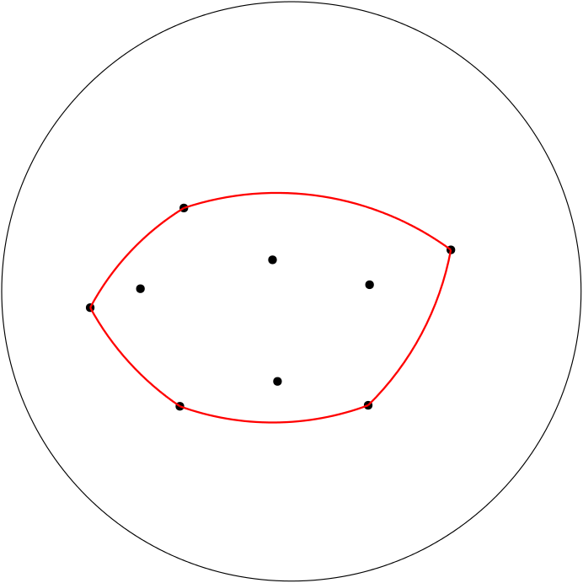
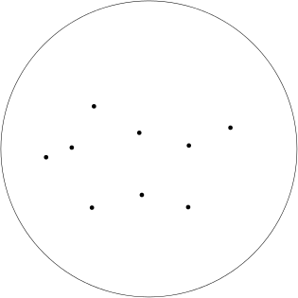
Circular hulls
A circular hull of radius r for a set Q of points is the common intersection of all disks of radius r containing Q
It exists iff Q can be covered by a disk of radius r

Slide 5
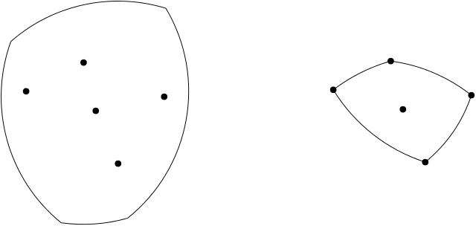
Properties of circular hulls
The circular hull of radius r for Q is dual to the common intersection of all disks of radius r centered at the points of Q
Some differences between convex hulls and circular hulls:
The circular hull of radius r may not exist
An extreme point of Q (e.g., the leftmost point) may not be a vertex of the circular hull

Slide 6
Computing the circular hull
Previous work
O(n log n) time (α-hull), Edelsbrunner, Kirkpatrick, and Seidel, 83’
O(n log n) time, Hershberger and Suri, 91’
Our result
O(n) time after sorting
Similar to Graham’s scan

Slide 7
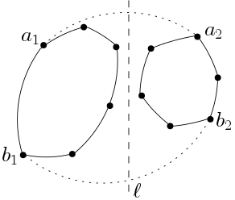
Computing the common tangents
Input: circular hulls of two point sets separated by a line
Output: the two common tangents
they may not exist
Previous work
Linear time, Hershberger and Suri, 91’
Our result
O(log n) time

Slide 8
A dynamic circular hull problem
Maintain the circular hull of a set Q of points in the plane
Insertion: insert a point to the right of all points of the current Q
Deletion: delete the leftmost point of the current Q
Determine whether the circular hull exists after each update
Our result: O(1) amortized time for each update
Previous work:
O(log n) amortized time for deletions only (arbitrary deletions), Hershberger and Suri, 91’

Slide 9
A dynamic circular hull maintenance problem (cont.)
Points are cyclically sorted around a point

Slide 10
2-center problem
Input: a set S of n points in the plane
Output: a pair of congruent disks of smallest radius that together cover all points of S
r*: the radius of the disks in an optimal solution

Slide 11
Two cases
D₁ and D₂: the two disks in an optimal solution such that the distance of their centers is minimized
The distant case: the centers of D₁ and D₂ are far away
The distance of the centers is ≥ r*
The nearby case: the centers of D₁ and D₂ are very close
The distance of the centers is < r*
r*
r*
distant case
nearby case

Slide 12
Algorithms for the two cases
Distant case
O(n log² n ) time, Eppstein 97’
Nearby case
O(n log⁹ n) time, Sharir 97’
O(n log n loglog n ) expected time, Eppstein 97’
O(n log n) time w.h.p., Chan 99’
O(n log² n log²log n) time, Chan 99’
O(n log n loglog n), our result

Slide 13
Our algorithm for the nearby case
Parametric search
Decision problem:
Given a value r, decide whether r ≥ r*, i.e., whether it is possible to use a pair of congruent disks of radius r to cover all points

Slide 14
Our algorithm for the nearby case (cont.)
Follow Chan’s algorithm framework
Decision problem
O(n log n) time, Chan 99’
Our result: O(n) time, after O(n log n) preprocessing
Optimization problem: a parallel decision algorithm
O(log n log²log n) parallel steps with O(n log n) processors, Chan 99’
Our result: O(log n loglog n) parallel steps with O(n) processors

Slide 15
Observation
D₁ and D₂: the two disks in an optimal solution of the 2-center problem
We can find a point o in the intersection of D₁ and D₂
The two rays together partition the input point set S into two subsets covered by D₁ and D₂, respectively
r* is equal to the larger radius of the smallest enclosing disks of the two subsets
Assume: o is the origin
Assume: the x-axis separates the two rays
D₂
D₁
o
x

Slide 16
Notation
A[i,j]: the radius of the smallest enclosing disk of all points to the left of the two rays
B[i,j]: the radius of the smallest enclosing disk of all points to the right of the two rays
r* =min_{0 ≤ i, j ≤ n}max{A[i,j], B[i,j]}
p_{i+1}
p_{i}
p₂
p_{n}
p₁
x
q₁
o
q_{n}
q₂
q_{j+1}
q_{j}

Slide 17
Decision algorithm
p_{i+1}
p_{i}
p₂
p_{n}
p₁
q₁
o
q_{n}
Given a value r, decide whether r ≥ r*?
For each i, find the largest j such that A[i,j] ≤ r
check whether B[i,j] ≤ r
How to decide whether A[i,j] ≤ r?
O(log n) time, Chan 99’
Our result: O(1) amortized time (after sorting)
q₂
q_{j+1}
q_{j}

Slide 18
Decision algorithm
p_{i+1}
p_{i}
p₂
p_{n}
p₁
q₁
o
q_{n}
Observation: all elements of A (resp., B) checked in the algorithm form a monotone path
The problem reduces to the dynamic circular hull problem
O(1) amortized time for each update
Time for the decision algorithm: O(n)
q₂
q_{j}
q_{j+1}

Slide 19
Conclusions
2-center problem: O(n log² n) time
distant case: O(n log²n) time
nearby case: O(n log n loglog n) time
A new result: O(n log n) time, Choi and Ahn (arXiv, June 18, 2020)
Open: Does an o(n log²n) algorithm exist?
The distant case is the bottleneck
Thank you for your attention!

