Slide 1
Bicriteria Rectilinear Shortest Paths among Rectilinear Obstacles in the Plane
Haitao Wang
Utah State University
SoCG 2017, Brisbane, Australia

Slide 2
The rectilinear minimum-link path problem
Input: a rectilinear domain P of n vertices and h holes, and two points s and t
Output: a rectilinear minimum-link s-t path
t
s

Slide 3
The rectilinear shortest path problem
Input: a rectilinear domain P of n vertices and h holes, and two points s and t
Output: a rectilinear shortest s-t path
t
s

Slide 4
Bicriteria: a shortest minimum-link path
The shortest path among all minimum-link paths
t
s

Slide 5
Bicriteria: a minimum-link shortest path
The minimum-link path among all shortest paths
t
s

Slide 6
Question: Does there always exists a path that is both a shortest min-link path and a min-link shortest path?
Simple rectilinear polygons (no holes): Yes!
With holes: No!
s
t

Slide 7
Three types of bicriteria paths
Min-link shortest paths
Shortest min-link paths
Minimum-cost paths
The cost of a path: a non-decreasing function of both the length and the number of edges of the path
One-point queries
s is given in the input, and t is a query point
Two-point queries
Both s and t are query points

Slide 8
Previous work: for all three types of bicriteria paths
Finding a single path
O(n²) time, Yang et al., 1992
O(n log²n) time and O(n log n) space, Yang et al., 1995
O(n log^{1.5}n) time and space, Yang et al., 1995
O(n log^{1.5}n) time and O(n log n) space, Chen et al., 2001
One-point queries, Chen et al., 2001
Preprocessing: O(n log^{1.5}n) time and O(n log n) space
Query: O(log n) time
Two-point queries, Chen et al., 2001
Preprocessing: O(n² log²n) time and space
Query: O(log² n) time

Slide 9
A rectilinear domain of n vertices and h holes
h could be much smaller than n
Complexities better measured by h instead of by n
e.g., O(n²) vs. O(n + h²)
n = 39
h = 3

Slide 10
Our results: Finding a single path
O(n²) time, Yang et al., 1992
O(n log²n) time and O(n log n) space, Yang et al., 1995
O(n log^{1.5}n) time and space, Yang et al., 1995
O(n log^{1.5}n) time and O(n log n) space, Chen et al., 2001
Our results:
Find an error in all the previous algorithms
Correct the error:
Min-link shortest paths: O(n log^{1.5}n) and O(n log n) space
Shortest min-link paths and min-cost paths: O(n² log^{1.5}n) and O(n² log n) space
Further improvement:
Min-link shortest paths: O(n + h log^{1.5}h) and O(n + h log h) space
Shortest min-link paths and min-cost paths: O(n + h² log^{1.5}h) and O(n + h² log h) space

Slide 11
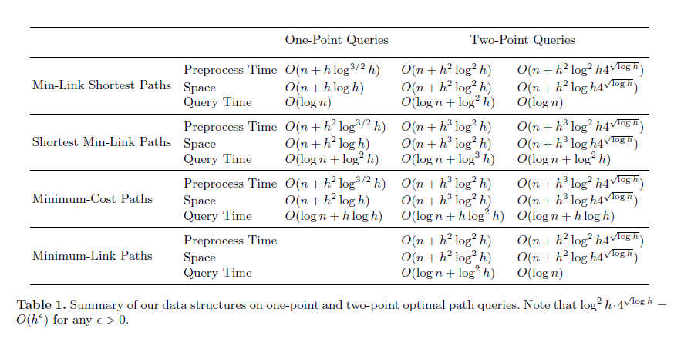
Our results: Queries

Slide 12
A “path-preserving” graph, Clarkson et al. 87’
Cut-lines
Steiner points
V: the set of all vertices of P;
G(V): the graph, O(n log n) nodes and edges
t
s

Slide 13
Observations on G(V)
Why “path-preserving”?
A shortest s-t path in G(V) is a shortest s-t path in P, Clarkson et al. 87’
For finding a bicriteria path:
G(V) contains a target path from s to t, such that if we follow the path and apply a dragging operation on each edge, then we can obtain a bicriteria path, Yang et al. 96’
t
f
h
d
e
b
c
s
a

Slide 14
The algorithm, Yang et al., 96’
Run Dijkstra’s algorithm on G(v) from s and apply the dragging operation on each visited edge
Maintain at most eight paths at each node
For min-link shortest path: use the lexicographical vector (L(π), D(π)) as the key for any path π
L(π): the length of π
D(π): the number of links of π

Slide 15
The error
L(π₁) = L(π₂), D(π₁) = 4, D(π₂) = 5
Yang et al: It is not necessary to maintain π₂ at p since D(π₁) < D(π₂)
Not correct!!
π₂ can lead to a better path to t
Our correction: If the D values of two paths of the same type differ by one, then both may need to be maintained
At most 16 paths need to be maintained at each node (for min-link shortest paths)
O(n) paths for other two bicriteria paths
t
p
π₁
π₂
s

Slide 16
Further improvement
Goal: Make complexities depend only on h, in addition to O(n)
E.g., O(n log^{1.5} n) → O(n + h log^{1.5} h)
The main tool of the previous algorithm is G(V) of size O(n log n)
Our idea for improvement
Use a smaller graph G(B) of size O(h log h)
B: a set of O(h) backbone points
G(B) is built w.r.t. B

Slide 17
The corridor structure of P
The vertical decomposition of P, VD(P)
Extend each vertical edge until the boundary of P

Slide 18
The corridor structure of P
Consider the dual graph G of the VD(P)
Keep removing the degree-one nodes from G
Keep contracting the degree-two nodes

Slide 19
The corridor structure of P
The remaining graph G’ is called “corridor graph”
Each vertex of G’ defines a “junction rectangle”
Each edge of G’ defines a “corridor”

Slide 20
The corridor structure of P
Each corridor is a simple polygon, and has two doors connecting with its neighboring junction rectangles
O(h) corridors

Slide 21
Defining backbone points on corridors
An open corridor has 4 backbone points, two on each door
A closed corridor has 2 backbone points, one on each door
backbone points
w₂
d₂
d₂
w₁
d₁
d₁
open
closed

Slide 22
The reduced path-preserving graph G(B)
G(B) is defined w.r.t. the set B of all backbone points (including s and t), in the same way as G(V) defined w.r.t. V
In addition, each closed corridor defines a corridor edge in G(B)
which is an edge connecting p and q, with weight equal to the length of a shortest p-to-q path in the corridor
Path-preserving: A shortest s-t path in G(B)
is a shortest s-t path in P
q
p

Slide 23
The algorithm
Run Dijkstra’s algorithm on G(B) by performing dragging operations on ordinary edges of G(B)
The key difference:
For each corridor edge, perform a new type of operation: corridor-path generating operation
The main challenge of our approach
Need to implement it in O(log n) time
q
Question: Can we simply connect p to q by
an arbitrary bicriteria path in the corridor?
p
NO!!
s

Slide 24
The corridor-path generating operations
a is above p
a is to the
left of p
a
q
q
p
a
p
s
s
q
q
p
p
a
a
s
s
a is below p but not on the door
a is below p and is on the door

