Slide 1
Lecture: Review Session
Datacenters, energy proportionality, GPUs – watch posted
recordings
Final exam details:
  Tuesday 12/13, 1pm – 3pm
  80%+ on post-midterm material
  A couple “unseen” problems, a few “short-response” questions
  3+3 reference sheets (double sided)
  Show steps; calculators allowed

Slide 2
Hardware Trends
Why the recent emphasis on accelerators?
  Stagnant single- and multi-thread performance with general-purpose cores
    Dark silicon (emphasis on power-efficient throughput)
    End of scaling
    No low-hanging fruit
  Emergence of deep neural networks

Slide 3









Commercial Hardware
Machine Learning accelerators
Google TPU (inference and training)
Recent NVIDIA chips (Volta, NVDLA)
Microsoft Brainwave, Catapult
Intel Loihi and Nervana
Cambricon
Graphcore (training)
Cerebras (training)
Groq (inference)
Tesla FSD (inference)

Slide 4
Machine Learning Workloads
Dominated by dot-product computations
Deep neural networks: convolutional and fully-connected layers
Convolutions exhibit high data reuse
Fully-connected layers have high memory-to-compute ratio

Slide 5
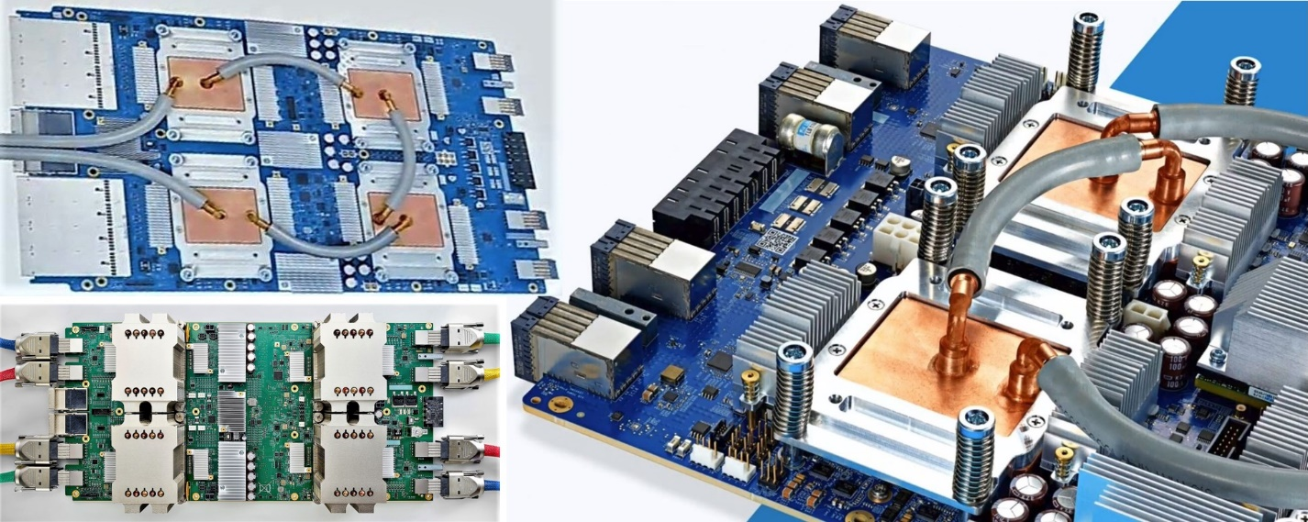
Google TPU
Version 1: 15-month effort, basic design, only for inference, 92 TOPs peak, 15x faster than GPU, 40 W 28nm 300 mm² chip
Version 2: designed for training, a pod is a collection of v2 chips connected with a torus topology
Version 3: 8x higher throughput, liquid cooled
Ref: Google

Slide 6
TPU Architecture
8 GB
256 KB
24 MB
Weights are pre-loaded during previous
phase and inputs flow left to right.

Slide 8
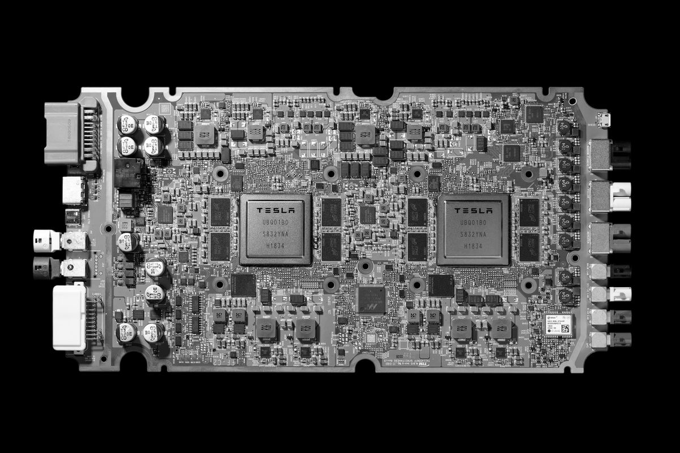
Tesla FSD
Tesla’s custom accelerator chip, shipping in cars since April 2019
FSD sits behind the glovebox, consumes 72W
18 months for first design, next generation out in 2 years
Image Source: Tesla

Slide 9
NN Accelerator Chip (NNA)
Goals: under 100 W (2% impact on driving range, cooling, etc.), 50 TOPs, batch size of 1 for low latency, GPU support as well, security/safety.
Security: all code must be attested by Tesla
Safety: two completely independent systems on the board that verify every output
The FSD 2.5 design (GPU based) consumes 57 W, the 3.0 design consumes 72 W, but is 21x faster (72 TOPs)
20% saving in cost by designing their own chip

Slide 10
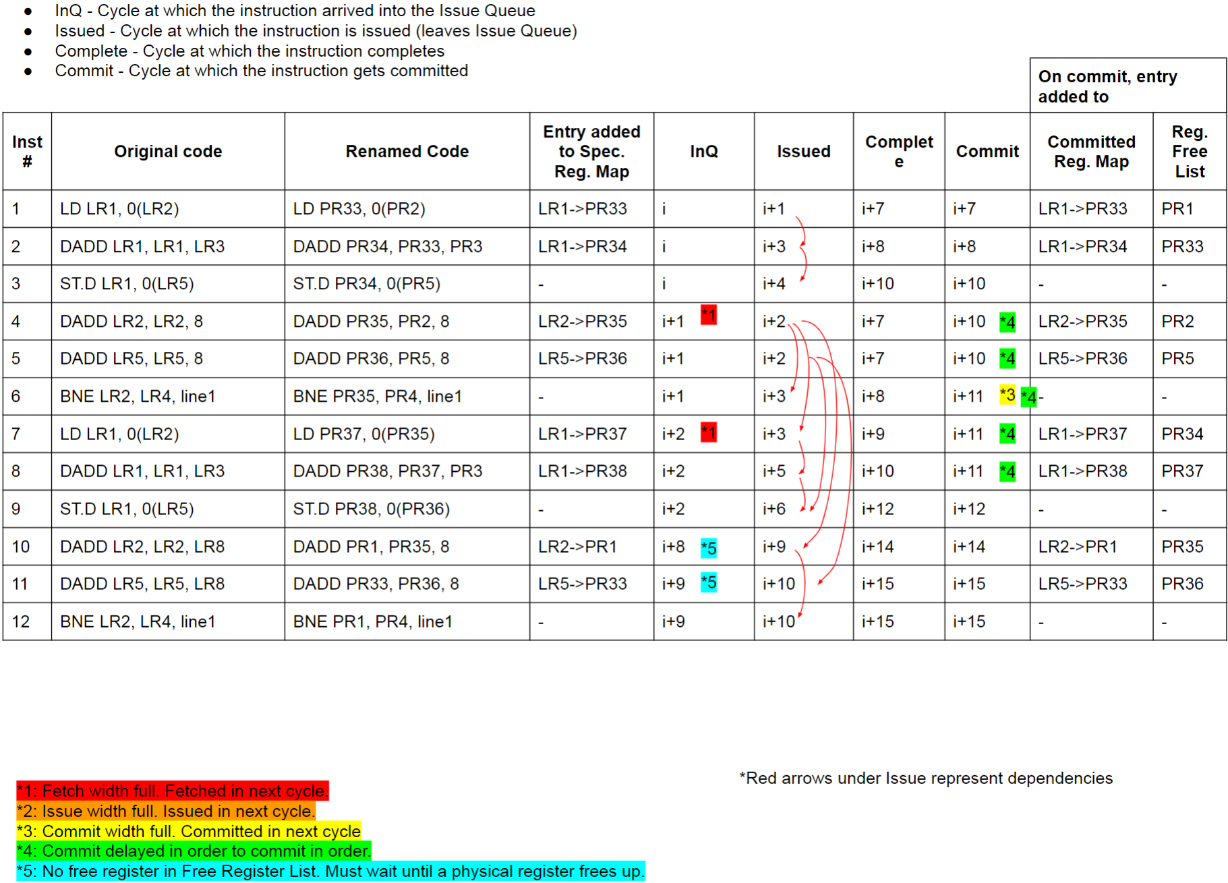
OoO Timeline

Slide 11
Problem 4
Consider the following LSQ and when operands are
available. Estimate when the address calculation and
memory accesses happen for each ld/st. Assume
memory dependence prediction.
Ad. Op St. Op Ad.Val Ad.Cal Mem.Acc
LD R1 ← [R2] 3 abcd
LD R3 ← [R4] 6 adde
ST R5 → [R6] 4 7 abba
LD R7 ← [R8] 2 abce
ST R9 → [R10] 8 3 abba
LD R11 ← [R12] 1 abba

Slide 12
Problem 1
Memory access time: Assume a program that has cache
access times of 1-cyc (L1), 10-cyc (L2), 30-cyc (L3), and
300-cyc (memory), and MPKIs of 20 (L1), 10 (L2), and 5 (L3).
Should you get rid of the L3?
With L3: 1000 + 10x20 + 30x10 + 300x5 = 3000
Without L3: 1000 + 10x20 + 10x300 = 4200

Slide 13
Problem 3
Assume a 2-way set-associative cache with just 2 sets.
Assume that block A maps to set 0, B to 1, C to 0, D to 1,
E to 0, and so on. For the following access pattern,
estimate the hits and misses:
A B B E C C A D B F A E G C G A
M MH M MH MM HM HMM M H M

Slide 14
Problem 5
8 KB fully-associative data cache array with 64
byte line sizes, assume a 40-bit address
How many sets (1) ? How many ways (128) ?
How many index bits (0), offset bits (6), tag bits (34) ?
How large is the tag array (544 bytes) ?
Equations:
Data array size (cache size) = #sets x #ways x blocksize
Tag array size = #sets x #ways x tagsize
Index bits = log₂ (#sets)
Offset bits = log₂ (blocksize)
Tag bits + index bits + offset bits = address width

Slide 15
Problem 3
Assume that page size is 16KB and cache block size is 32 B.
If I want to implement a virtually indexed physically tagged
L1 cache, what is the largest direct-mapped L1 that I can
implement? What is the largest 2-way cache that I can
implement?

Slide 16
Similar to HW 7, Q1
Assume a large shared LLC that is tiled and distributed on the
chip. Assume that the OS page size is 16KB. The entire LLC has a
size of 32 MB, uses 128-byte blocks, and is 32-way set-associative.
What is the maximum number of tiles such that the OS has full
flexibility in placing a page in a tile of its choosing?

Slide 17
Problem 1
What is the maximum memory capacity supported by the
following server: 2 processor sockets, each socket has
4 memory channels, each channel supports 2 dual-ranked
DIMMs, and x4 4Gb DRAM chips?
2 sockets x 4 channels x 2 DIMMs x 2 ranks x
16 chips x 4Gb capacity = 256 GB
What is the memory bandwidth available to the server if
each memory channel runs at 800 MHz?
2 sockets x 4 channels x 800M (cycles per second) x
2 (DDR, hence 2 transfers per cycle) x 64 (bits per transfer)
= 102.4 GB/s

Slide 18
Problem 4
For the following access stream, estimate the finish times for
each access with the following scheduling policies:
Req Time of arrival Open Closed Oracular
X 10 ns 50 50 50
X+1 15 ns 70 70 70
Y 100 ns 160 140 140
Y+1 180 ns 200 220 200
X+2 190 ns 260 300 260
Y+2 205 ns 320 240 320
Note that X, X+1, X+2, X+3 map to the same row and Y, Y+1
map to a different row in the same bank. Ignore bus and
queuing latencies. The bank is precharged at the start.
** A more sophisticated oracle can do even better.

Slide 19
Problem 5
Consider a single 4 GB memory rank that has 8 banks.
Each row in a bank has a capacity of 8KB. On average,
it takes 40ns to refresh one row. Assume that all 8 banks
can be refreshed in parallel. For what fraction of time will
this rank be unavailable? How many rows are refreshed
with every refresh command?
The memory has 4GB/8KB = 512K rows
There are 8K refresh operations in one 64ms interval.
Each refresh operation must handle 512K/8K = 64 rows
Each bank must handle 8 rows
One refresh operation is issued every 7.8us and the
memory is unavailable for 320ns, i.e., for 4% of time.

Slide 20
Meltdown
Attacker code
Fill the cache with your own data X
lw R1 ← [illegal address]
lw … ← [R1]
Scan through X and record time per access

Slide 21
Spectre: Variant 1
x is controlled by attacker
Thanks to bpred, x can be anything
array1[ ] is the secret
Victim Code
if (x < array1_size)
y = array2[ array1[x] ];
Access pattern of array2[ ] betrays the secret

Slide 22
Spectre: Variant 2
Victim code
R1 ← (from attacker)
R2 ← some secret
Label0: if (…)
Attacker code
Label0: if (1)
Label1: …
…
…
Victim code
Label1:
lw [R2]

Slide 23
Snooping Example
Request | Cache Hit/Miss | Request on the bus | Who responds | State in Cache 1 | State in Cache 2 | State in Cache 3 | State in Cache 4
 |  |  |  | Inv | Inv | Inv | Inv
P1: Rd X | Miss | Rd X | Memory | S | Inv | Inv | Inv
P2: Rd X | Miss | Rd X | Memory | S | S | Inv | Inv
P2: Wr X | Perms Miss | Upgrade X | No response. Other caches invalidate. | Inv | M | Inv | Inv
P3: Wr X | Write Miss | Wr X | P2 responds | Inv | Inv | M | Inv
P3: Rd X | Read Hit | - | - | Inv | Inv | M | Inv
P4: Rd X | Read Miss | Rd X | P3 responds. Mem wrtbk | Inv | Inv | S | S

Slide 24
Directory Example
Request | Cache Hit/Miss | Messages | Dir State | State in C1 | State in C2 | State in C3 | State in C4
 |  |  |  | Inv | Inv | Inv | Inv
P1: Rd X | Miss | Rd-req to Dir. Dir responds. | X: S: 1 | S | Inv | Inv | Inv
P2: Rd X | Miss | Rd-req to Dir. Dir responds. | X: S: 1, 2 | S | S | Inv | Inv
P2: Wr X | Perms Miss | Upgr-req to Dir. Dir sends INV to P1. P1 sends ACK to Dir. Dir grants perms to P2. | X: M: 2 | Inv | M | Inv | Inv
P3: Wr X | Write Miss | Wr-req to Dir. Dir fwds request to P2. P2 sends data to Dir. Dir sends data to P3. | X: M: 3 | Inv | Inv | M | Inv
P3: Rd X | Read Hit | - | - | Inv | Inv | M | Inv
P4: Rd X | Read Miss | Rd-req to Dir. Dir fwds request to P3. P3 sends data to Dir. Memory wrtbk. Dir sends data to P4. | X: S: 3, 4 | Inv | Inv | S | S

Slide 25
Test-and-Test-and-Set
lock: test register, location
bnz register, lock
t&s register, location
bnz register, lock
CS
st location, #0

Slide 26
Spin Lock with Low Coherence Traffic
lockit: LL R2, 0(R1) ; load linked, generates no coherence traffic
BNEZ R2, lockit ; not available, keep spinning
DADDUI R2, R0, #1 ; put value 1 in R2
SC R2, 0(R1) ; store-conditional succeeds if no one
; updated the lock since the last LL
BEQZ R2, lockit ; confirm that SC succeeded, else keep trying
If there are i processes waiting for the lock, how many
bus transactions happen?
1 write by the releaser + i (or 1) read-miss requests +
i (or 1) responses + 1 write by acquirer + 0 (i-1 failed SCs) +
i-1 (or 1) read-miss requests + i-1 (or 1) responses
(The i/i-1 read misses can be reduced to 1)

Slide 27
Example Programs
Initially, A = B = 0
P1 P2
A = 1 B = 1
if (B == 0) if (A == 0)
critical section critical section
Initially, A = B = 0
P1 P2 P3
A = 1
if (A == 1)
B = 1
if (B == 1)
register = A
Initially, Head = Data = 0
P1 P2
Data = 2000 while (Head == 0)
Head = 1 { }
… = Data

Slide 28
Problem 1
What are possible outputs for the program below?
Assume x=y=0 at the start of the program
Thread 1 Thread 2
A x = 10 a y=20
B y = x+y b x = y+x
C Print y
Possible scenarios: 5 choose 2 = 10
ABCab ABaCb ABabC AaBCb AaBbC
10 20 20 30 30
AabBC aABCb aABbC aAbBC abABC
50 30 30 50 30

Slide 29
Fences
P1 P2
{ {
Region of code Region of code
with no races with no races
} }
Fence Fence
Acquire_lock Acquire_lock
Fence Fence
{ {
Racy code Racy code
} }
Fence Fence
Release_lock Release_lock
Fence Fence

Slide 30
Deadlock
Deadlock happens when there is a cycle of resource
dependencies – a process holds on to a resource (A) and
attempts to acquire another resource (B) – A is not
relinquished until B is acquired

Slide 31
Topology Examples
Hypercube
Grid
Torus
Criteria 64 nodes | Bus | Ring | 2Dtorus | Hypercube | Fully connected
Performance Diameter Bisection BW | 1 1 | 32 2 | 8 16 | 6 32 | 1 1024
Cost Ports/switch Total links | 1 | 3 64 | 5 128 | 7 192 | 64 2016

Slide 32
k-ary d-Cube
Consider a k-ary d-cube: a d-dimension array with k
elements in each dimension, there are links between
elements that differ in one dimension by 1 (mod k)
Number of nodes N = k^{d}
Number of switches :
Switch degree :
Number of links :
Pins per node :
N
Avg. routing distance:
Diameter :
Bisection bandwidth :
Switch complexity :
d(k-1)/4
2d + 1
d(k-1)/2
Nd
2wk^{d-1}
2wd
(2d + 1)²
The switch degree, num links, pins per node, bisection bw for
a hypercube are half of what is listed above (diam and avg routing
distance are twice, switch complexity is ) because unlike
the other cases, a hypercube does not have right and left neighbors.
Should we minimize or maximize dimension?
(d + 1)²

Slide 33
Problem 1
Assume that a server consumes 100W at peak utilization
and 50W at zero utilization. Assume a linear relationship
between utilization and power. The server is capable of
executing many threads in parallel. Assume that a single
thread utilizes 25% of all server resources (functional units,
caches, memory capacity, memory bandwidth, etc.).
What is the total power dissipation when executing 99
threads on a collection of these servers, such that
performance and energy are close to optimal?
For near-optimal performance and energy, use 25 servers.
24 servers at 100% utilization, executing 96 threads,
consuming 2400W. The 25th server will run the last
3 threads and consume 87.5~W.

Slide 34
RAID 4 and RAID 5
Data is block interleaved – this allows us to get all our
data from a single disk on a read – in case of a disk error,
read all 9 disks
Block interleaving reduces thruput for a single request (as
only a single disk drive is servicing the request), but
improves task-level parallelism as other disk drives are
free to service other requests
On a write, we access the disk that stores the data and the
parity disk – parity information can be updated simply by
checking if the new data differs from the old data

