Slide 1
Lecture: Networks, Disks, Datacenters
Topics: networks wrap-up, disks and reliability,
datacenters and energy proportionality

Slide 2
Centralized Crossbar Switch
P0
P1
P2
P3
P4
P5
P6
P7

Slide 3
Crossbar Properties
Assuming each node has one input and one output, a
crossbar can provide maximum bandwidth: N messages
can be sent as long as there are N unique sources and
N unique destinations
Maximum overhead: WN² internal switches, where W is
data width and N is number of nodes
To reduce overhead, use smaller switches as building
blocks – trade off overhead for lower effective bandwidth

Slide 4
Switch with Omega Network
000
P0
000
001
P1
001
010
P2
010
011
P3
011
100
P4
100
101
P5
101
110
P6
110
111
P7
111

Slide 5
Omega Network Properties
The switch complexity is now O(N log N)
Contention increases: P0 → P5 and P1 → P7 cannot
happen concurrently (this was possible in a crossbar)
To deal with contention, can increase the number of
levels (redundant paths) – by mirroring the network, we
can route from P0 to P5 via N intermediate nodes, while
increasing complexity by a factor of 2

Slide 6
Tree Network
Complexity is O(N)
Can yield low latencies when communicating with neighbors
Can build a fat tree by having multiple incoming and outgoing links
P0
P1
P2
P3
P4
P5
P6
P7

Slide 7
Bisection Bandwidth
Split N nodes into two groups of N/2 nodes such that the
bandwidth between these two groups is minimum: that is
the bisection bandwidth
Why is it relevant: if traffic is completely random, the
probability of a message going across the two halves is
½ – if all nodes send a message, the bisection
bandwidth will have to be N/2
The concept of bisection bandwidth confirms that the
tree network is not suited for random traffic patterns, but
for localized traffic patterns

Slide 8
Topology Examples
Hypercube
Grid
Torus
Criteria 64 nodes | Bus | Ring | 2Dtorus | Hypercube | Fully connected
Performance Bisection bandwidth
Cost Ports/switch Total links

Slide 9
Topology Examples
Hypercube
Grid
Torus
Criteria 64 nodes | Bus | Ring | 2Dtorus | Hypercube | Fully connected
Performance Diameter Bisection BW | 1 1 | 32 2 | 8 16 | 6 32 | 1 1024
Cost Ports/switch Total links | 1 | 3 64 | 5 128 | 7 192 | 64 2016

Slide 10
k-ary d-cube
Consider a k-ary d-cube: a d-dimension array with k
elements in each dimension, there are links between
elements that differ in one dimension by 1 (mod k)
Number of nodes N = k^{d}
Number of switches :
Switch degree :
Number of links :
Pins per node :
Avg. routing distance:
Diameter :
Bisection bandwidth :
Switch complexity :
Should we minimize or maximize dimension?

Slide 11
k-ary d-Cube
Consider a k-ary d-cube: a d-dimension array with k
elements in each dimension, there are links between
elements that differ in one dimension by 1 (mod k)
Number of nodes N = k^{d}
Number of switches :
Switch degree :
Number of links :
Pins per node :
N
Avg. routing distance:
Diameter :
Bisection bandwidth :
Switch complexity :
d(k-1)/4
2d + 1
d(k-1)/2
Nd
2wk^{d-1}
2wd
(2d + 1)²
The switch degree, num links, pins per node, bisection bw for
a hypercube are half of what is listed above (diam and avg routing
distance are twice, switch complexity is ) because unlike
the other cases, a hypercube does not have right and left neighbors.
Should we minimize or maximize dimension?
(d + 1)²

Slide 12
Warehouse-Scale Computer (WSC)
100K+ servers in one WSC
~$150M overall cost
Requests from millions of users (Google, Facebook, etc.)
Cloud Computing: a model where users can rent compute
and storage within a WSC; there’s an associated
service-level agreement (SLA)
Datacenter: a collection of WSCs in a single building,
possibly belonging to different clients and using different
hardware/architecture

Slide 13
PUE Metric and Power Breakdown
PUE = Total facility power / IT equipment power
(power utilization effectiveness)
It is greater than 1; ranges from 1.33 to 3.03, median of 1.69
The cooling power is roughly half the power used by
servers
Within a server, the approximate power distribution is as
follows: Processors (33%), DRAM memory (30%),
Disks (10%), Networking (5%), Miscellaneous (22%)

Slide 14
CapEx and OpEx
Capital expenditure: infrastructure costs for the building,
power delivery, cooling, and servers
Operational expenditure: the monthly bill for energy,
failures, personnel, etc.
CapEx can be amortized into a monthly estimate by
assuming that the facilities will last 10 years, server
parts will last 3 years, and networking parts will last 4

Slide 15
CapEx/OpEx Case Study
8 MW facility : facility cost: $88M, server/networking
cost: $79M
Monthly expense: $3.8M. Breakdown:
Servers 53% (amortized CapEx)
Networking 8% (amortized CapEx)
Power/cooling infrastructure 20% (amortized CapEx)
Other infrastructure 4% (amortized CapEx)
Monthly power bill 13% (true OpEx)
Monthly personnel salaries 2% (true OpEx)

Slide 16
Improving Energy Efficiency
An unloaded server dissipates a large amount of power
Ideally, we want energy-proportional computing, but in
reality, servers are not energy-proportional
Can approach energy-proportionality by turning on a few
servers that are heavily utilized
See figures on next two slides for power/utilization profile
of a server and a utilization profile of servers in a WSC

Slide 17
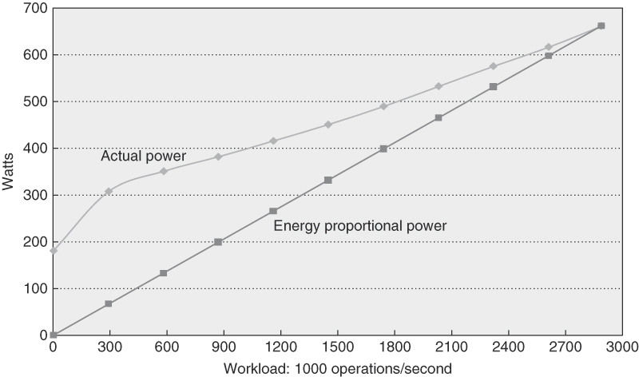
Power/Utilization Profile

Slide 18
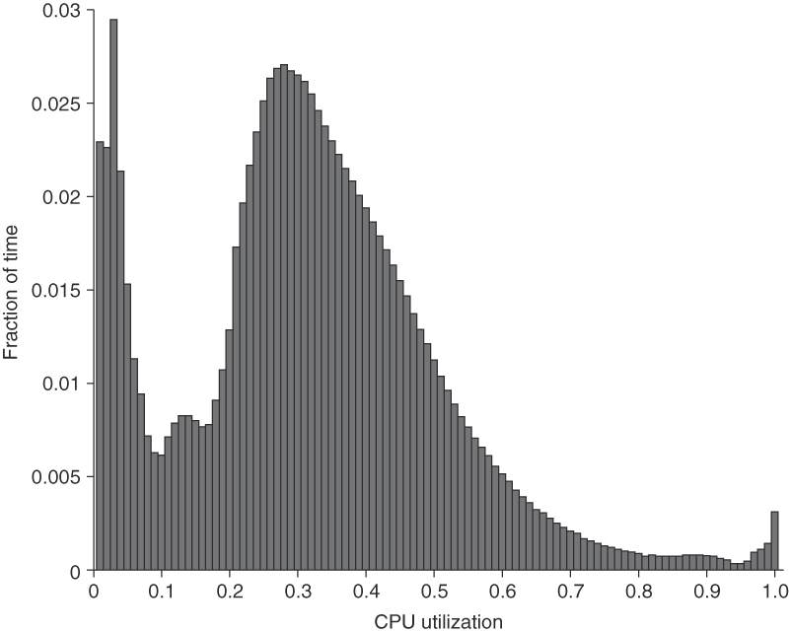
Server Utilization Profile
Figure 6.3 Average CPU utilization of more than 5000 servers during a 6-month period at Google. Servers are rarely completely idle or fully utilized, in-stead operating most of the time at between 10% and 50% of their maximum utilization. (From Figure 1 in Barroso and Hölzle [2007].) The column the third from the right in Figure 6.4 calculates percentages plus or minus 5% to come up with the weightings; thus, 1.2% for the 90% row means that 1.2% of servers were between 85% and 95% utilized.

Slide 19
Problem 1
Assume that a server consumes 100W at peak utilization
and 50W at zero utilization. Assume a linear relationship
between utilization and power. The server is capable of
executing many threads in parallel. Assume that a single
thread utilizes 25% of all server resources (functional units,
caches, memory capacity, memory bandwidth, etc.).
What is the total power dissipation when executing 99
threads on a collection of these servers, such that
performance and energy are close to optimal?

Slide 20
Problem 1
Assume that a server consumes 100W at peak utilization
and 50W at zero utilization. Assume a linear relationship
between utilization and power. The server is capable of
executing many threads in parallel. Assume that a single
thread utilizes 25% of all server resources (functional units,
caches, memory capacity, memory bandwidth, etc.).
What is the total power dissipation when executing 99
threads on a collection of these servers, such that
performance and energy are close to optimal?
For near-optimal performance and energy, use 25 servers.
24 servers at 100% utilization, executing 96 threads,
consuming 2400W. The 25th server will run the last
3 threads and consume 87.5~W.

Slide 21
Other Metrics
Performance does matter, both latency and throughput
An analysis of the Bing search engine shows that if a
200ms delay is introduced in the response, the next
click by the user is delayed by 500ms; so a poor
response time amplifies the user’s non-productivity
Reliability (MTTF) and Availability (MTTF/MTTF+MTTR)
are very important, given the large scale
A server with MTTF of 25 years (amazing!) : 50K servers
would lead to 5 server failures a day; Similarly, annual disk
failure rate is 2-10% ➔ 1 disk failure every hour

Slide 22
Important Problems
Reducing power in power-down states
Maximizing utilization
Reducing cost with virtualization
Reducing data movement
Building a low-power low-cost processor
Building a low-power low-cost hi-bw memory
Low-power low-cost on-demand reliability

Slide 23
Magnetic Disks
A magnetic disk consists of 1-12 platters (metal or glass
disk covered with magnetic recording material on both
sides), with diameters between 1-3.5 inches
Each platter is comprised of concentric tracks (5-30K) and
each track is divided into sectors (100 – 500 per track,
each about 512 bytes)
A movable arm holds the read/write heads for each disk
surface and moves them all in tandem – a cylinder of data
is accessible at a time

Slide 24
Disk Latency
To read/write data, the arm has to be placed on the
correct track – this seek time usually takes 5 to 12 ms
on average – can take less if there is spatial locality
Rotational latency is the time taken to rotate the correct
sector under the head – average is typically more than
2 ms (15,000 RPM)
Transfer time is the time taken to transfer a block of bits
out of the disk and is typically 3 – 65 MB/second
A disk controller maintains a disk cache (spatial locality
can be exploited) and sets up the transfer on the bus
(controller overhead)

Slide 25
RAID
Reliability and availability are important metrics for disks
RAID: redundant array of inexpensive (independent) disks
Redundancy can deal with one or more failures
Each sector of a disk records check information that allows
it to determine if the disk has an error or not (in other words,
redundancy already exists within a disk)
When the disk read flags an error, we turn elsewhere for
correct data

Slide 26
RAID 0 and RAID 1
RAID 0 has no additional redundancy (misnomer) – it
uses an array of disks and stripes (interleaves) data
across the arrays to improve parallelism and throughput
RAID 1 mirrors or shadows every disk – every write
happens to two disks
Reads to the mirror may happen only when the primary
disk fails – or, you may try to read both together and the
quicker response is accepted
Expensive solution: high reliability at twice the cost

Slide 27
RAID 3
Data is bit-interleaved across several disks and a separate
disk maintains parity information for a set of bits
For example: with 8 disks, bit 0 is in disk-0, bit 1 is in disk-1,
…, bit 7 is in disk-7; disk-8 maintains parity for all 8 bits
For any read, 8 disks must be accessed (as we usually
read more than a byte at a time) and for any write, 9 disks
must be accessed as parity has to be re-calculated
High throughput for a single request, low cost for
redundancy (overhead: 12.5%), low task-level parallelism

Slide 28
RAID 4 and RAID 5
Data is block interleaved – this allows us to get all our
data from a single disk on a read – in case of a disk error,
read all 9 disks
Block interleaving reduces thruput for a single request (as
only a single disk drive is servicing the request), but
improves task-level parallelism as other disk drives are
free to service other requests
On a write, we access the disk that stores the data and the
parity disk – parity information can be updated simply by
checking if the new data differs from the old data

Slide 29
RAID 5
If we have a single disk for parity, multiple writes can not
happen in parallel (as all writes must update parity info)
RAID 5 distributes the parity block to allow simultaneous
writes

Slide 30
Other Reliability Approaches
High reliability is also expected of memory systems;
many memory systems offer SEC-DED support – single
error correct, double error detect; implemented with an
8-bit code for every 64-bit data word on ECC DIMMs
Some memory systems offer chipkill support – the ability
to recover from complete failure in one memory chip – many
implementations exist, some resembling RAID designs
Caches are typically protected with SEC-DED codes
Some cores implement various forms of redundancy,
e.g., DMR or TMR – dual or triple modular redundancy

