Slide 1
LogKV: Exploiting Key-Value Stores for Event Log Processing
Zhao Cao*, Shimin Chen*, Feifei Li#, Min Wang*, X. Sean Wang$
* HP Labs China # University of Utah $ Fudan University

Slide 2
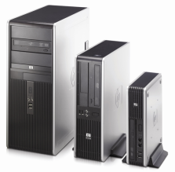
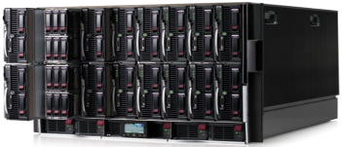
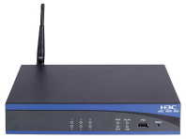
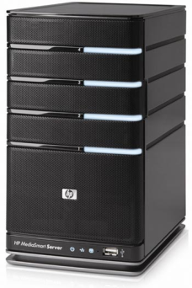
Introduction
Event log processing and analysis are important for enterprises
Collect event records from a wide range of HW devices and SW systems
Support many important applications
Security management
IT trouble shooting
User behavior analysis
☞ What are the requirements of a good event log management system?
Event Log Management System
Log events

Slide 3
Requirements of Event Log Processing
Support increasingly large amount of log data
Growing system scales
Pressures on log storage, processing, reliability
Support diverse log formats
Different log sources often have different formats
Multiple types of events in the same log (e.g., unix syslog)
Support both interactive exploratory queries and batch computations
Selections (e.g., time range is a required filter condition)
Window joins (e.g., Sessionization)
Log data join reference tables
Aggregations
Flexibly incorporating user implemented algorithms

Slide 4
Design Goals
Satisfying all requirements
Log data size (scalability & reliability)
Log formats
Query types
Flexibility
Goal for log data size
10 PB total log data
A peak ingestion throughput of 100 TB/day

Slide 5
Related Work
Existing distributed solutions for log processing
Batch computation on logs: e.g., using Map/Reduce [Blanas et al 2010]
Commercial products support only selection queries in distributed processing
This work: Batch & ad-hoc + many query types
Event log processing different from data streams processing
Distributed data streams: pre-defined operations, real-time processing [Cherniack et al 2003]
This work: storing and processing a large amount of log event data
Data stream warehouse
Centralized storage and processing of data streams [Golab et al. 2009]
This work: distributed solution for high-volume high-throughput log processing

Slide 6
Exploiting Key-Value Stores
Key-Value stores
Dynamo, BigTable, SimpleDB, Cassandra, PNUTS
Good fit for log processing
Widely used to provide large-scale, highly-available data storage
Different event record formats easily represented as key-value pairs
Easy to apply filtering for good performance
Can flexibly support user functions
☞ But directly applying Key-Value stores cannot achieve all goals

Slide 7
Challenges
Storage overhead
Use as fewer machines as possible to reduce cost
10PB x 3 copies = 30PB; 10TB disk space per machine
3000 machines are required!
5:1/10:1/20:1 compression ➔ 600/300/150 machines
Query performance
Minimize inter-machine communications
Selection is easy, but what about joins?
Window joins ➔ co-locate log data of every time range
Log ingestion throughput
10PB / 3 years ~ 10TB/day
Allow up to 100TB/day: sudden bursts, removal of less important data
Or 1.2GB / second

Slide 8
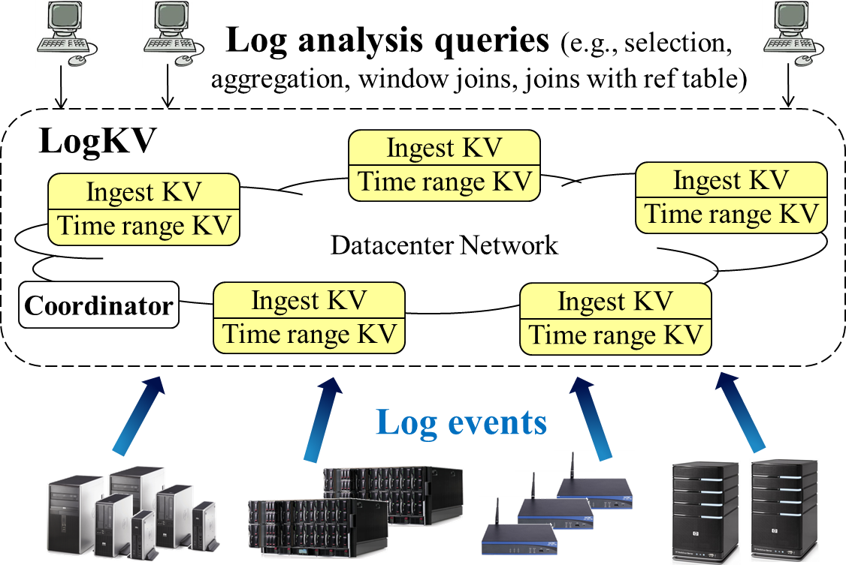
Our Solution: LogKV

Slide 9
Questions to Answer
Reliability
Query Processing
TimeRangeKV
Log Sources
Mapping
IngestKV
Shuffling
KV store
Data Compression

Slide 10
Log Source Mapping
Log Sources
Mapping
IngestKV
Our goal: balance log ingestion bandwidth across LogKV nodes
Three kinds of log sources
LogKV runs an agent on the log source
Configure log source to forward log events (e.g., unix syslog)
ftp/scp/sftp
In-dividable log sources: a greedy mapping algorithm
Sort log sources by ingestion throughput
Assign the next heaviest log source to the next light loaded node
Log node BW < average BW + max in-dividable BW
Dividable log sources: assign to balance BW as much as possible
Dividable
In-dividable

Slide 11
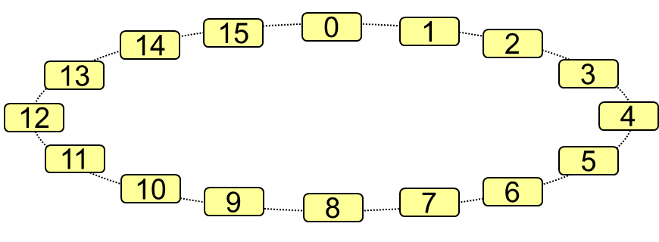
Log Shuffling
TimeRangeKV
IngestKV
Shuffling
KV store
Co-locate all the log data in the same time range
Divide time into TRU (Time Range Unit) sized chunks
Assign TRUs in a round robin fashion across logKV nodes
TimeRangeKV node ID = $\left\lfloor \frac{TimeStamp}{TRU}\right\rfloor \% N$
Naïve implementation
Accumulate log data for one TRU time
Shuffle log data
But there is only a single destination node!
☞ Avoid communication bottleneck in shuffling

Slide 12
Log Shuffling Cont’d
Accumulate M TRUs before shuffling
Distribute shuffle load to M destinations
During shuffling, a destination randomly picks source nodes
15
0
1
14
2
13
3
12
4
11
5
10
6
9
8
7
N=16 M=4

Slide 13
Other Components in LogKV
Data compression
Event records in a TRU are stored in columns
Bitmaps for missing values
Reliability
Keep 3 copies in TimeRangeKV
Keep 2 copies IngestKV
Query processing
Selection: fully distributed
Window joins: fully distributed, TRU is chosen according to common window size
Other joins: map-reduce like operation, follow prior work
Approximate query processing

Slide 14
Experimental Results
Prototype implementation
Underlying Key-Value store is Cassandra
IngestKV and TimerangeKV written in Java
Implementation of shuffling, compression, and basic query processing
Experimental setup
A cluster of 20 blade servers (HP ProLiant BL460c, two 6-core Intel Xeon X5675 3.06GHz CPUs, 96GB memory, and a 7200rpm HP SAS hard drive)
Real-world log event trace from a popular web site
For large data experiments, we generate synthetic data based on the real data

Slide 15
Log Ingestion Throughput
An event record is about 100 byte large
20 nodes achieve about 600MB/s throughput
Suppose linear scaling, 1.2GB/s target throughput requires about 40 nodes

Slide 16
Window Join Performance
Self-join for each 10 second window
Cassandra: Map/Reduce based join implementation
HDFS: Store raw event log in HDFS and Map/Reduce based join implementation
LogKV: join within each TRU
LogKV achieves :
15x speed up comparing with Cassandra
11x speed up comparing with HDFS

Slide 17
Conclusion
Event log processing and analysis are important for enterprises
LogKV
Exploit Key-Value stores for scalability, reliability, and supporting diverse formats
Support high-throughput log ingestion
Support efficient queries (e.g. window-based join queries)
Experimental evaluation shows LogKV is a promising solution

Slide 18
Thank you!

