Slide 1



Compass
Debjyoti Paul, Feifei Li, Murali Krishna Teja, Xin Yu, Richie Frost
COMPREHENSIVE ANALYTICS ON SENTIMENT FOR SPATIO-TEMPORAL DATA
USE CASE: SPATIO TEMPORAL SENTIMENT ANALYSIS OF US ELECTION 2016
23rd SIGKDD Conference on Knowledge Discovery and Data Mining
APPLIED DATA SCIENCE TRACK
LAB
Notes:
Good Afternoon,
I will be presenting a framework called
Compass: Comprehensive Analytics on Sentiment for Spatiotemporal Data
and a use case of such framework: SPATIOTEMPORAL SENTIMENT ANALYSIS of US ELECTION 2016
I am Debjyoti Paul the lead author of this paper.
This work has been done at InitialDLab, School of Computing in University of Utah.

Slide 2
Motivation
- Recognize emerging social issues and events
- Understanding crowd reaction and societal response to events
Notes:
In the last decade we have seen widespread growth of social network tools and platforms,
Analyzing and understanding of social network data enables us to
- Recognize emerging social issues and events
- also to understand crowd reaction and societal response to such events

Slide 3

Motivation
Openness in sharing their views about public events
- Twitter, Facebook, Google+
- Emergency and calamity services
- apps with location information (Uber, Instagram etc.)
Notes:
This is possible because people are proactive and reactive in nature.
They tend to share their views in social media platforms
twitter and facebook..
.. and these apps gathers location information which can reveals patterns worth looking into.

Slide 4
Motivation
Collective crowd opinion matters
- crowd response changes with time
- location
Notes:
We know that collective opinion matters…
But it is also important to know that
-- crowd response changes with time
-- location

Slide 5

Motivation
Factors motivated us:
- Ubiquitous Geotagged Data
- Measure Community Influence
- Local Socio-Economic Events
- Local Health–Food indicators
- PubMed 2017
Social media indicators of the food environment and state health outcomes.
- AJPH 2017
Geotagged U.S. Tweets as Predictors of County-Level Health Outcomes
- Local Ad-targeting framework
Notes:
The factors motivated us:
- are Ubiquitous Geotagged Data
- that can Measure Community Influence
- and find Local Socio-Economic Events
- also it helps in finding Local Health–Food indicators over time
We have collaborated with Health department of University of Utah
and their work is published PubMed and American Public Journal for Health
- and also for Local Ad-targeting framework

Slide 6
Challenges & Solution

Slide 7
Challenges
Large volume of data
Realtime
Clean up/filter non-relevant data
Generic Topic Classification techniques
Sentiment Analysis
Adhoc query support
Information representation
Notes:
So the challenges are that we have to deal with large volume of data in realtime. Preprocess them and filter the non-relevant data.
Create a generic topic classification module.
Have a sentiment analysis module in place ..
add adhoc query support for analytics
and UI for information representation.

Slide 8

Solution - COMPASS
Comprehensive Analytics on Sentiment for Spatiotemporal data
A Framework with MINIMAL human hand curation
- Scalable
- Streaming and batch
- Easy configurable - YAML
- Pluggable – (WebSocket/HTTP-REST/Program)
- Data Sources
- Machine learning models
- Adhoc pluggable modules
- Bursty Event Detection module
- Analytics Support
- SIMBA- Spatial In-Memory Big Analytics SIGMOD 2016
- APIs for UI
Notes:
So we present Compass:
It is a framework that needs minimal human hand curation
- It is Scalable.. Each worker can work independently.
- It can support streaming and batch data processing
- It can be Easily configurable according to data and purpose just with YAML file
- where we specify the Machine Learning Models can which can either be used as service
OR downloaded OR use as API
-
- Adhoc modules can be added for independent processing –
- We added Bursty Event detection module for US Election use case
- Analytics support from SIMBA- Spatial-In Memory Big Analytics- published in SIGMOD 2016
- and APIs for UI

Slide 9
Solution - COMPASS
Use case: Spatio Temporal Sentiment Analysis of US Election 2016
Peoples sentiment play vital role
Cumulative Opinion matters
Geographical location matters
Reaction to pre-election events matters
Notes:
The use case we present here is
- Spatio-temporal Sentiment Analysis of US Election 2016
In democracy peoples opinion and sentiment matters….
- compass captures pre-election reaction of people via tweets
Keeping this in mind Election is a best use case we can have for demonstration of Compass.

Slide 10
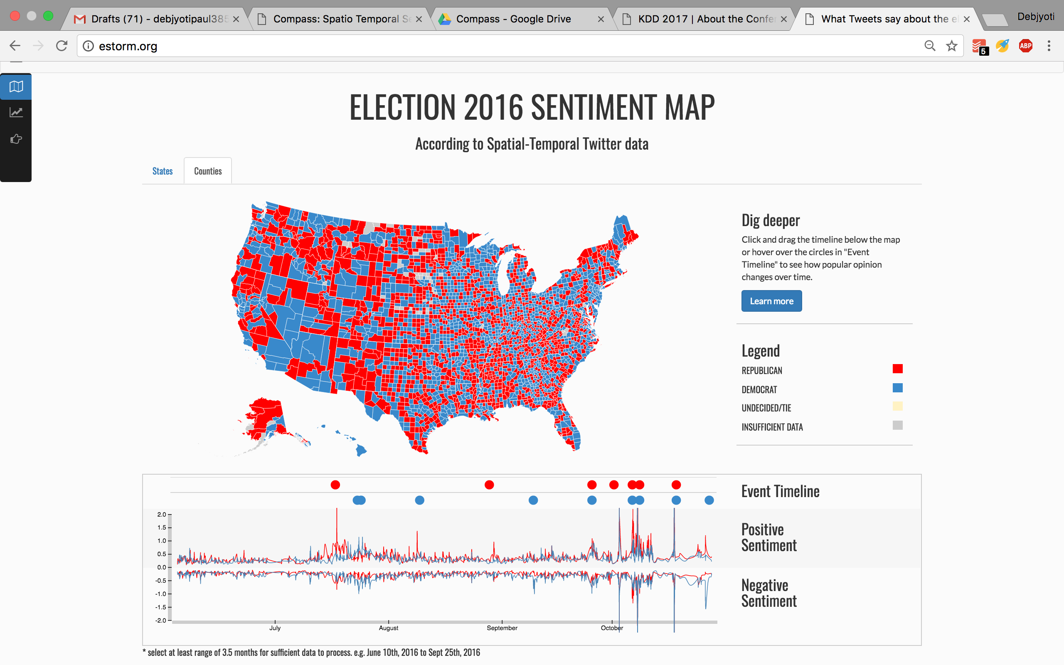
US Election SENTIMENT MAP
http://estorm.org
Notes:
This is the end result of US Election Sentiment Map.
You can find it at ESTORM.ORG
At the bottom timeline we have bursty events with their scores. We can very well discover events and crowd sentiment about that event.
Red signifies that republicans have more average positive sentiment from crowd than Democrats and blue is vice versa.
By the way this shows county level analysis not Electoral voting or Electoral district. Aggregation at the state level can also be seen in another visualization.

Slide 11
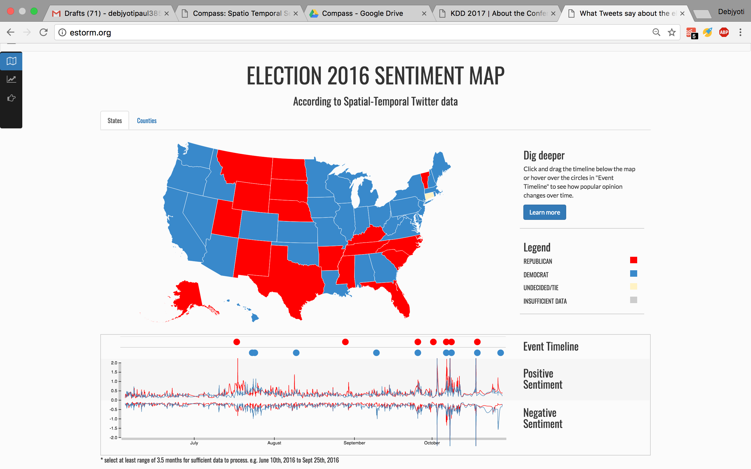
US Election SENTIMENT MAP
http://estorm.org
Notes:
You can select the range in timeline too for analysis for that specified time.

Slide 12
COMPASS ARCHITECTURE

Slide 13
COMPASS ARCHITECTURE - US ELECTION
Notes:
This is the Compass Architecture for US Election
- We have a Data source module to collect geotagged tweets at the top.
Then we have series of Machine Learning Modules
Tweet Classification Model
Sentiment Analysis Model
A geomapping module
A database
Spatio-temporal Analytics System
And adhoc Bursty Event Detection System.
And an Interactive Data visualization
In a generic compass architecture you can add any number of ML modules through YAML configuration file.

Slide 14
COMPASS Modules
Geo-data Collection Module
Tweet Classification Model
Sentiment Analysis Model
Bursty Event Detection Model
Spatio Temporal Analysis Framework
Visualization
Notes:
I will go through each of them briefly

Slide 15
GEOData Collection
Twitter APIs:
- 1% Streaming API
- Location based search API
Gather maximum geotagged tweets: (286 million)
- Partition search location
- Prioritize location queries based on density
- Create location based search bounding box queries such
they collect almost equal number of tweets
- Round-robin schedule of queries
Observation:
- Places in New York City will generate more
tweets than a place Southern Utah
Notes:
We have a geotagged tweet collection module.
It uses 1% streaming twitter API and location based search API..
But to gather maximum geotagged tweets we partitioned region based on density..
The intuition is places like New York City will generate more tweets than rural places of US.
First, we collected few days of 1% tweet stream
- analyzed the source location-density of tweets
- created bounding boxes for equal distribution.
Then used location based search API for collecting tweets.

Slide 16
Political Tweets
Political Tweets Classification:
Challenges:
- Keywords filter approach not feasible
- incomprehensive list
- doesn’t guarantee correct classification (same word
two meaning)
- Machine Learning methods
- need labeled dataset
- need manual labor
- large enough dataset
Notes:
One of the challenge is political tweet classification ...
- Keywords or Hashtag filter is always incomprehensive.. And same word can have different meaning in different context
- on the Other hand ML models need large enough labeled datasets
which is hard to get.

Slide 17
Classification
Notes:
We use this following approach..
First we crawl news articles and run topic modeling on it.
We look for the class that can be marked as politics .. We call these keywords as seeds.
On a different segment we create a word2vec model from general 8.5 million tweets. K-nearest neighbors of seeds are drawn from model to create another richer set called enriched keywords set.
The only place where human intervention is required is here.. Where enriched set of keywords in labelled by expert.
This keywords are then used to labelled tweets i.e. training data. But making sure that .. We remove those keywords from tweets.

Slide 18
Political Tweets
Political Tweets Classification:
Approach:
- Minimal hand curation
- Get the best of both the approaches (Keywords, ML )
- Use Topic modeling to get political keywords
- Use word2vec model trained on 8.5 million tweets
- Prepare training data
- Prepare unbiased model
Notes:
This slides mentions exactly what I described in previous slide.

Slide 19
Political Tweets
Political Tweets Classification:
Approach:
- Seeds: Keywords from topic model
- Enriched Keywords:
- Similar words with seeds
- k-nearest neighbor from seeds in word2vec
- Cosine distance
Notes:
For k-nearest neighbors we used cosine distances to create enriched set

Slide 20
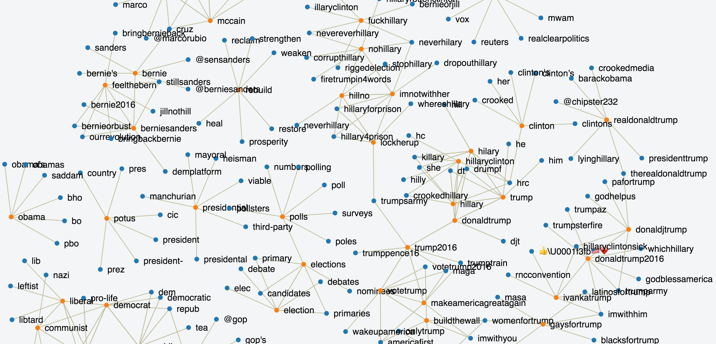
Political Tweets
Notes:
This is the representation of seeds with their k-nearest neighbors

Slide 21
PARTY ClASSIFICATION
Party Classification:
Approach:
- Map: Enriched Keywords <=> Democrat / Republican
-- Only manual task in whole pipeline
-- 300 keywords labeled by the experts
(crowdsourcing)
- Prepare training data from these data
- But how to prepare unbiased model ?
- remove keywords from data used to filter
- generic approach for all type of classification
- Sports, Finance, Health, Food etc.
Notes:
The political party classification is done with the labelled keywords of the experts explained earlier.
We make sure the model is unbiased and learns the context by removing keywords from the tweets.
I will present their effectiveness in results section.

Slide 22
Sentiment Model
Compass’ sentiment model (SENT) can be instantiated with different classifiers:
- SVM based (SENT1)
- LR based (SENT2)
- MNB based (SENT3)
- LSTM-RNN based (SENT4)
- FastText based (SENT5)
Training Data:
Stanford Twitter Sentiment Corpus (A. Go, et. al)
Approach:
- Sentiment Score range: [0.0, 1.0]
- Towards 0.0 negative sentiment
- Towards 1.0 positive sentiment
Notes:
For sentiment model we have different classifiers
- We tried with SVM, Logistic regression, Multinomial Naïve Bayes, LSTM-RNN, And Facebook FastText
We trained them on Stanford Twitter Sentiment Corpus ..
Sentiment scores are in the range 0 to 1
Where towards 0 means negative and towards 1 means positive
0.5 is neutral.
We have all the models.. and just plug it in configuration to use them.

Slide 23
GEOMAPping MODULE
Mapping of geotagged tweets to counties is important for faster processing:
- Web services are inefficient
- Compass uses high precision GeoJSON
- A geo-tree based approach
-- country → state → county as nodes
-- Efficient computation
Notes:
For faster analytics we map each tweet to it’s county and state.
A geo tree based approach for efficient computation ..
First country then state and then county

Slide 24
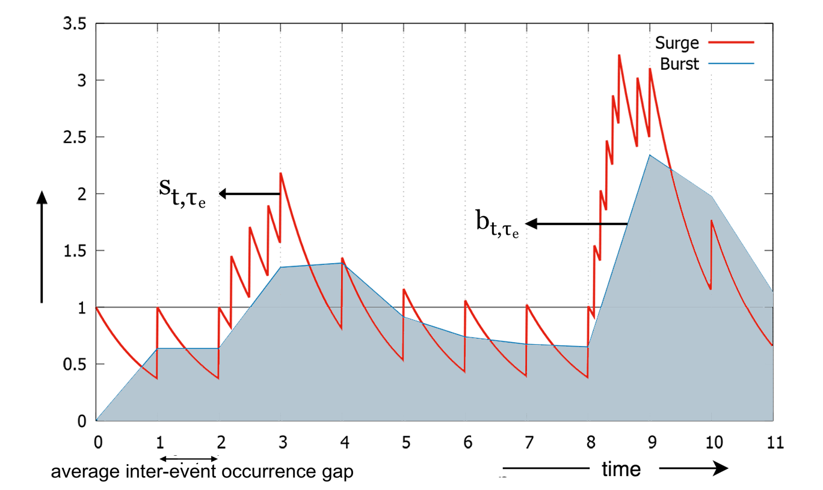
Bursty Event Detection
(Definition 1) Burst. Burst is a phenomenon identified when at least n number of event occurrences (of the same event) happens in τ time where τ is determined from probability distribution of gaps between occurrences.
Notes:
This is the adhoc module in place ..
Bursty Event Detection..
We define burst is a phenomenon identified when at least n number of event occurrences happens in τ time where τ is determined from probability distribution of gaps between occurrences.

Slide 25
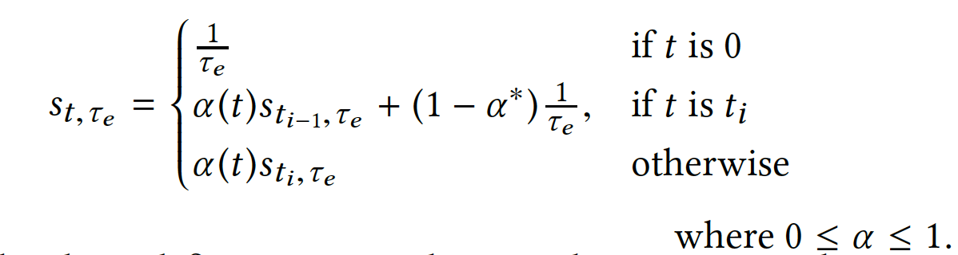
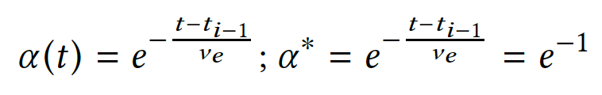
Bursty Event Detection
S_{e} ={a₀,a₁,a₂,...,a_{m−1},a_{m},...} a data stream of microblog article a_{i} about the same event e each with timestamps t_{i}.
We define term surge s_{t,τe}
α is a the time variant smoothing parameter, α* when t-t_{i-1=} ν_{e}
Notes:
We have definition for surge which is continuous measure of frequent occurrences of event. We derive burstiness from from surge as area under the curve.
The gray portion or the area under the curve is measure of burstiness for any event.
I won’t go much mathematical detail of the formulation..

Slide 26
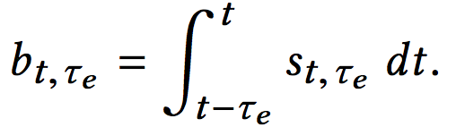
Bursty Event Detection
S_{e} is extracted from a stream S that has a mixture of microblog articles with mentioning of different events.
(Definition 2) Burstiness. We define burstiness of event e at time
t as area under the curve of surge over time τ_{e} .
b_{t,τe} is the basis of bursty event detection module
Notes:
We will publish a separate paper in recent future on the data-structure to efficiently implement such model.
I would love to address any of your question for this part offline to save time of presentation and not to digress.

Slide 27
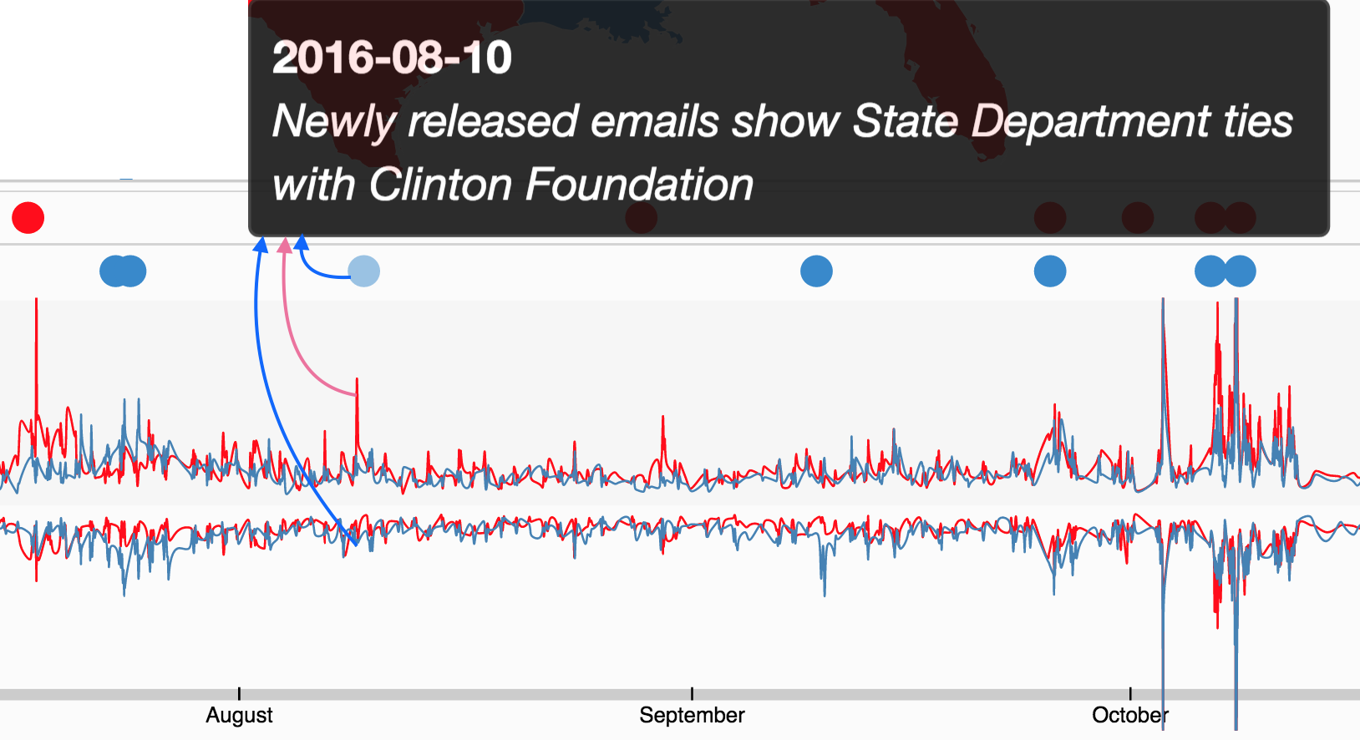
Bursty Event Detection
Two types of query can be invoked:
Q_{e,[start,end]} where e is an event type represented by a keyword and [start,end] defines
a query time window.
Q_{[start,end],γ} where γ is a threshold.
Query 1 returns s_{t,τe} and b_{t,τe} streams for e
Query 2 returns all elements whose b_{t,τe} value has exceeded threshold in interval [start,end].
Notes:
We can query this module to generate the timeline graph shown.

Slide 28

Spatio-temporal Analytics SIMBA-(SIGMOD 2016)
Compass provide fast, scalable, and high-throughput spatial and temporal queries and analytics for location-based services (LBS)
Compass integrates and uses Simba (Spatial In-Memory Big data Analytics) - Scalable
- Efficient in-memory spatial query processing and analytics
- Meant for Spatiotemporal data.
Compass use HTTP RESTful API interface interacting in SQL with Simba
Interactive web visualization system
- Build with D3.js for election sentiment map
- http://www.estorm.org
Notes:
Compass is powered by Simba-
Simba is Spatial-In-Memory Analytics based on Apache Spark. This was published in SIGMOD 2016.
Compass use HTTP RESTful API interface interacting in SQL with Simba.

Slide 29
Experiment & Result

Slide 30
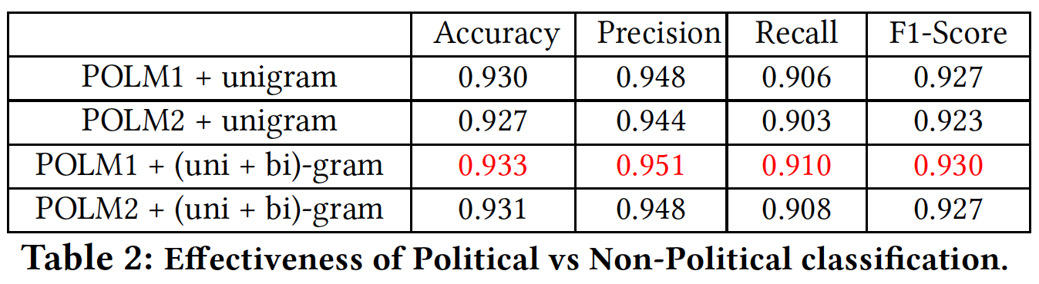
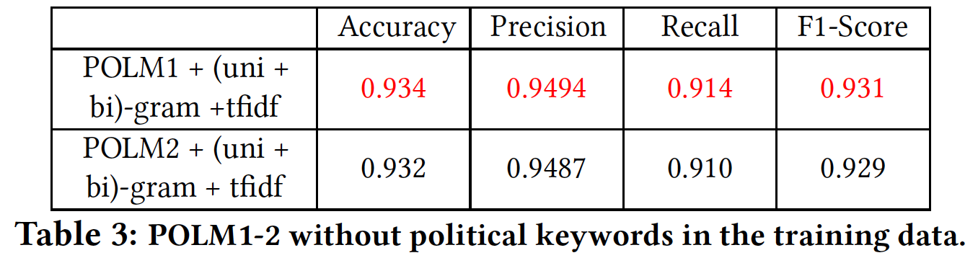
Experiment and result
Tweet Classification:
Political Model (POLM):
POLM1 – SVM based
POLM2 – LR based
Notes:
This is for political tweet classification
Table 2 shows scores with test data..
Table 3 shows scores with test data even after removing the keywords..
This shows how well the classifiers uses context to classify.

Slide 31
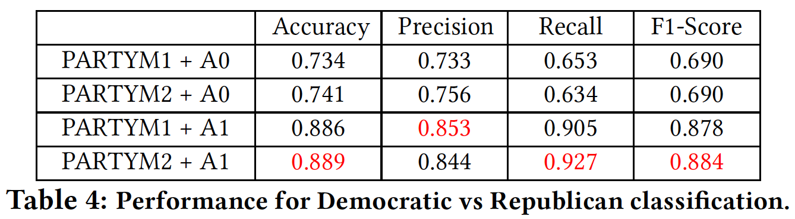
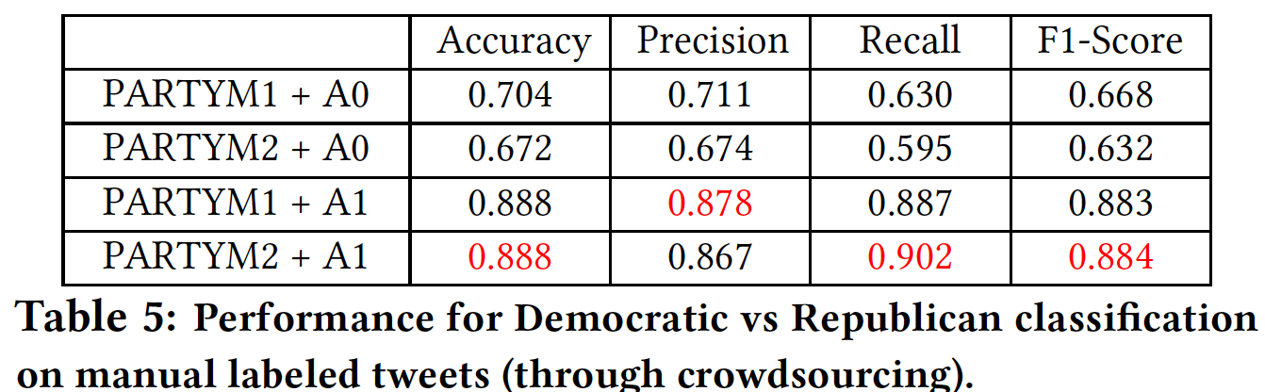
Experiment and result
Party Model (PARTYM):
PARTYM1 – SVM based
PARTYM2 – LR based
A0 – No keywords in training data
A1 – Only Trump & Hillary in training data
Party Classification:
Performance on crowdsourced labeled tweets and general testbed seems similar
Notes:
Table 4 shows scores for party classification on test data.
Table 5 on manually labelled tweets by crowdsourcing

Slide 32
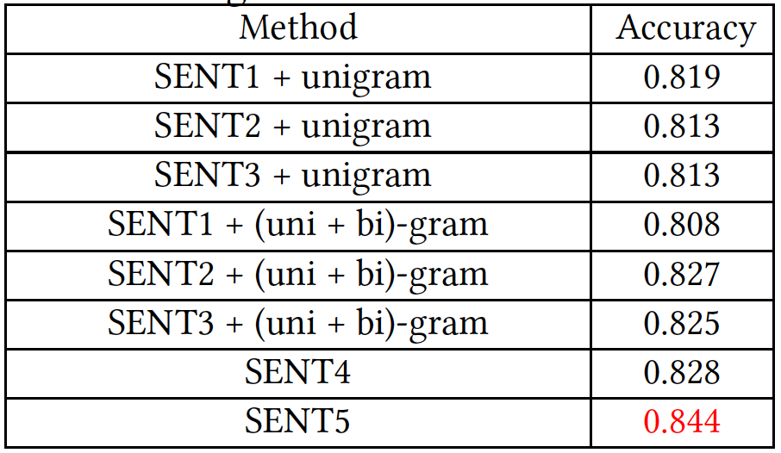
Experiment and result
Sentiment Classification:
Sentiment Model (SENT):
SENT1 – SVM based
SENT2 – LR based
SENT3 – MNB based
SENT4 – LSTM-RNN based
SENT5 – FastText based
1.6 million tweets from Stanford Twitter Sentiment (STS) for train and test
Notes:
We found that FastText beats other models in sentiment classification.

Slide 33
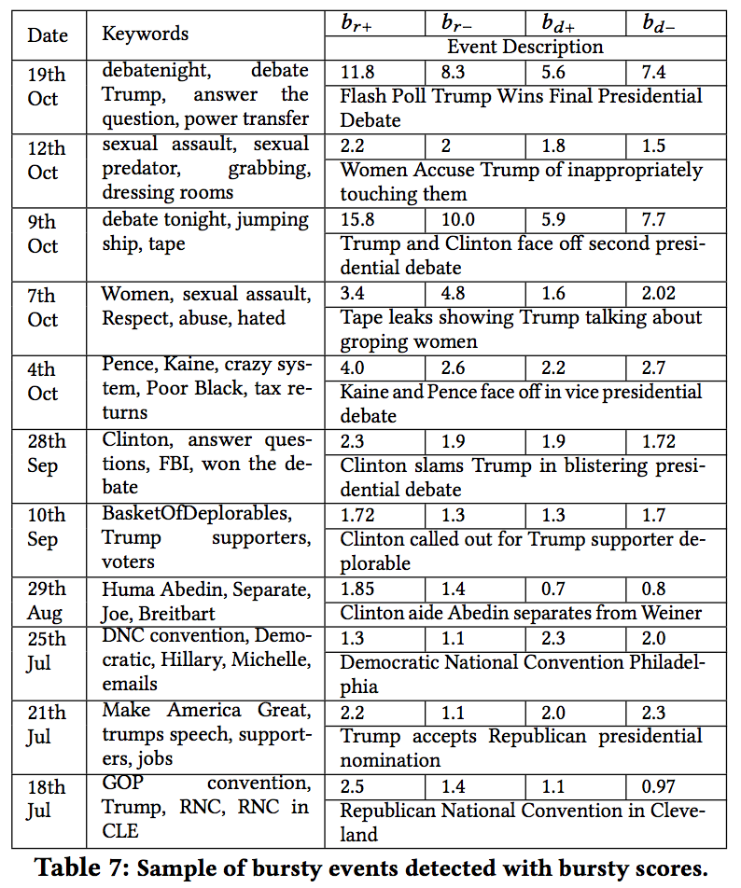
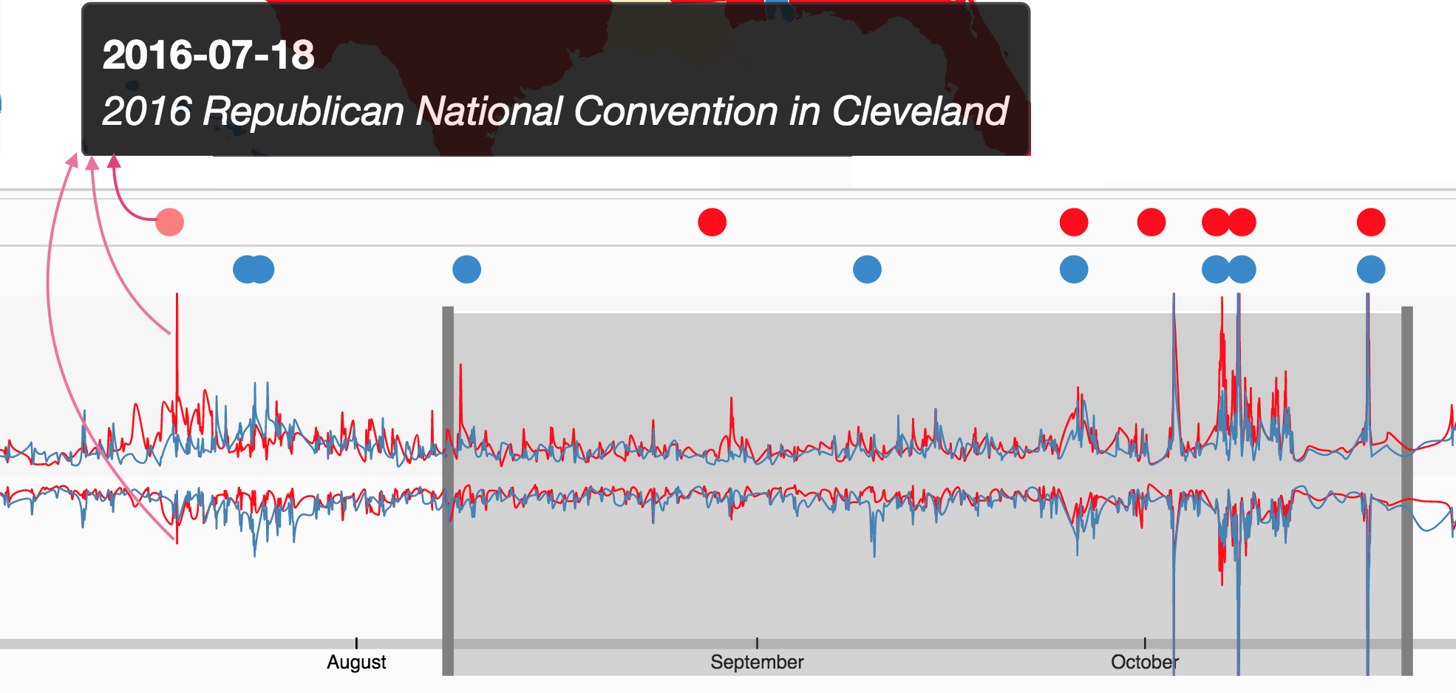
Experiment and result
Bursty Event Detection:
Notes:
The bursty event detection could detect all the pre-election event.
We also have burtiness score with for positive and negative tweets for both parties

Slide 34
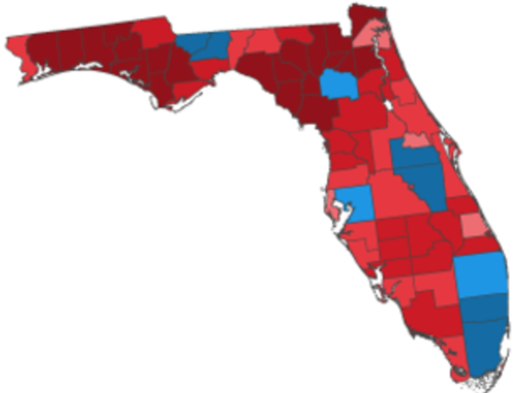
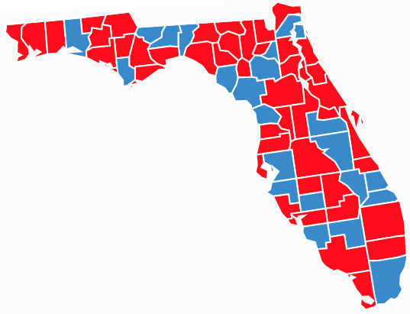
Experiment and result
Overall:
Florida actual election result
Florida sentiment analysis
Notes:
Lastly I will leave this results up to you .. If this sentiment analysis can be used as a feature for prediction.

Slide 35
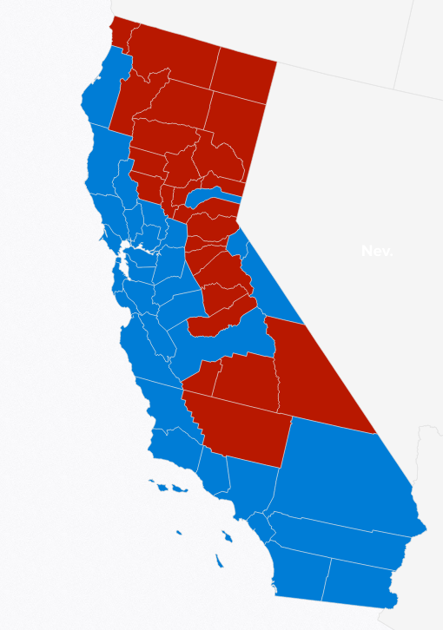
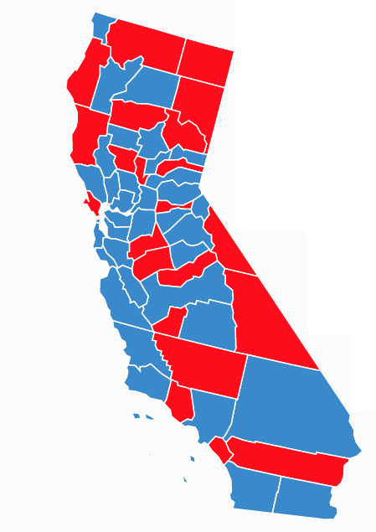
Experiment and result
Overall:
California actual election result
California sentiment analysis
Notes:
This is result for california.

Slide 36
conclusion

Slide 37
conclusion
Use case US Election 2016 proves that our approach is quite successful in achieving
what we aim for.
People reaction changes with time; so temporal query analysis makes more sense.
In terms of election result:
  Twitter reflects the voice of young generation mostly.
  Exit polls indicates former generation and non-graduate leans toward republican party
  and their percent- age is statistically significant. (source: NY Times Exit Polls)
Beyond election, Compass is a useful and generic end-to-end framework for spatio-temporal
sentiment analysis over any topic of interest.
Compass provides a configurable framework for diverse application.

Slide 38
References

Slide 39
references
[1] D. Agarwal and B.-C. Chen. da: matrix factorization through latent dirichlet allocation. In WSDM, 2010.
[2] L. AlSumait, D. Barbara ́, and C. Domeniconi. On-line lda: Adaptive topic models for mining text streams with applications to topic detection and tracking. In ICDM. IEEE, 2008.
[3] A. Anandkumar, D. P. Foster, D. J. Hsu, S. M. Kakade, and Y.-K. Liu. A spectral algorithm for latent dirichlet allocation. In NIPS, 2012.
[4] D. Anuta, J. Churchin, and J. Luo. Election bias: Comparing polls and twi er in the 2016 us election. arXiv:1701.06232, 2016.
[5] AOL. 2016 presidential election timeline, 2016. [accessed 08-02-2017].
[6] D. M. Blei. Probabilistic topic models. CACM, 55(4):77–84, 2012.
[7] D. M. Blei, A. Y. Ng, and M. I. Jordan. Latent dirichlet allocation. JMLR, 3(Jan):993–1022, 2003.
[8] P. Bojanowski, E. Grave, A. Joulin, and T. Mikolov. Enriching word vectors with subword information. arXiv preprint arXiv:1607.04606, 2016.
[9] A. Bovet, F. Morone, and H. A. Makse. Predicting election trends with twitter: Hillary clinton versus donald trump. arXiv:1610.01587, 2016.
[10] M. Cataldi, L. Di Caro, and C. Schifanella. Emerging topic detection on twitter based on temporal and social terms evaluation. In MDM/KDD, 2010.
[11] G. Cormode and S. Muthukrishnan. An improved data stream summary: The count-min sketch and its applications. In LATIN, 2004.
[12] C. N. Dos Santos and M. Gatti. Deep convolutional neural networks for sentiment analysis of short texts. In COLING, 2014.
[13] A. Duric and F. Song. Feature selection for sentiment analysis based on content and syntax models. Decision Support Systems, 53(4):704–711, 2011.
[14] A. El-Kishky, Y. Song, C. Wang, C. R. Voss, and J. Han. Scalable topical phrase mining from text corpora. PVLDB, 8(3), 2014.
[15] A. Genkin, D. D. Lewis, and D. Madigan. Large-scale bayesian logistic regression for text categorization. Technometrics, 49(3), 2007.
[16] A. Go, R. Bhayani, and L. Huang. Twi er sentiment classi cation using distant supervision. CS224N Project, Stanford, 1(12), 2009.
[17] F. Godin, V. Slavkovikj, W. De Neve, B. Schrauwen, and R. Van de Walle. Using topic models for twi er hashtag recommendation. In WWW, 2013.
[18] S. Hochreiter and J. Schmidhuber. Long short-term memory. Neural computation, 9(8):1735–1780, 1997.
[19] T. Hofmann. Probabilistic latent semantic analysis. In Uncertainty in artificial intelligence, pages 289–296, 1999.
[20] IETF. Rfc 7946 - the geojson format, 2017. [accessed 08-Feb-2017].
[21] L. Jiang, M. Yu, M. Zhou, X. Liu, and T. Zhao. Target-dependent twitter sentiment classification. In ACL HLT, pages 151–160.
[22] T. Joachims. Text categorization with support vector machines: Learning with many relevant features. In ECML, 1998.
[23] A. Joulin, E. Grave, P. Bojanowski, and T. Mikolov. Bag of tricks for effcient text classification. arXiv preprint arXiv:1607.01759, 2016.
[24] D. Kingma and J. Ba. Adam: A method for stochastic optimization. arXiv:1412.6980, 2014.
[25] J. Kleinberg. Bursty and hierarchical structure in streams. Data Mining and Knowledge Discovery, 7(4):373–397, 2003.

Slide 40
references
[26] E. Kouloumpis, T. Wilson, and J. D. Moore. Twi er sentiment analysis: e good the bad and the omg! Icwsm, 11(538-541), 2011.
[27] S. Lai, L. Xu, K. Liu, and J. Zhao. Recurrent convolutional neural networks for text classi cation. In AAAI, volume 333, pages 2267–2273, 2015.
[28] Q. Li, S. Shah, X. Liu, A. Nourbakhsh, and R. Fang. Tweetsi : Tweet topic classification based on entity knowledge base and topic enhanced word embedding. In CIKM, 2016.
[29] R. Lu and Q. Yang. Trend analysis of news topics on twi er. IJMLC, 2(3), 2012.
[30] A. McCallum, K. Nigam, et al. A comparison of event models for naive bayes text classification. In AAAI, volume 752, pages 41–48, 1998.
[31] L. Medsker and L. C. Jain. Recurrent neural networks: design and applications. CRC press, 1999.
[32] T. Mikolov, K. Chen, G. Corrado, and J. Dean. E cient estimation of word representations in vector space. arXiv:1301.3781, 2013.
[33] T. Mikolov, I. Sutskever, K. Chen, G. S. Corrado, and J. Dean. Distributed representations of words and phrases and their compositionality. In NIPS, pages 3111–3119, 2013.
[34] D.-P. Nguyen, R. Gravel, R. Trieschnigg, and T. Meder. ” how old do you think i am?” a study of language and age in twi er. 2013.
[35] B. Pang, L. Lee, et al. Opinion mining and sentiment analysis. FTIR, 2(1–2):1–135, 2008.
[36] PRC. Demographics of social media users in 2016, 2016. [accessed 08-Feb-2017].
[37] D. A. Shamma, L. Kennedy, and E. F. Churchill. Peaks and persistence: Modeling the shape of microblog conversations. In CSCW, 2011.
[38] M. Taboada, J. Brooke, M. To loski, K. Voll, and M. Stede. Lexicon-based methods for sentiment analysis. Computational Linguistics, 37(2):267–307, 2011.
[39] D. Tang, B. Qin, and T. Liu. Document modeling with gated recurrent neural network for sentiment classi cation. In EMNLP, pages 1422–1432, 2015.
[40] N. Y. Times. Election 2016: Exit polls, 2016.
[41] S. Vosoughi, H. Zhou, and D. Roy. Enhanced twitter sentiment classification using contextual information. arXiv:1605.05195, 2016.
[42] C. Wang and D. M. Blei. Collaborative topic modeling for recommending scientific articles. In SIGKDD, 2011.
[43] Z. Wei, G. Luo, K. Yi, X. Du, and J.-R. Wen. Persistent data sketching. In SIGMOD, 2015.
[44] Wikipedia. Swi gamma-ray burst mission — wikipedia, the free encyclopedia, 2016. [accessed 08-Feb-2017].
[45] D. Xie, F. Li, B. Yao, G. Li, L. Zhou, and M. Guo. Simba: Efficient in-memory spatial analytics. In SIGMOD, 2016.
[46] W. Xie, F. Zhu, J. Jiang, E.-P. Lim, and K. Wang. Topicsketch: Real-time bursty topic detection from twi er. In ICDM, pages 837–846, 2013.
[47] W. X. Zhao, J. Jiang, J. Weng, J. He, E.-P. Lim, H. Yan, and X. Li. Comparing twitter and traditional media using topic models. In ECIR, 2011.
[48] C. Zhou, C. Sun, Z. Liu, and F. Lau. A c-lstm neural network for text classification. arXiv:1511.08630, 2015.
[49] Y. Zhu and D. Shasha. E cient elastic burst detection in data streams. In SIGKDD, 2003.

Slide 41
Questions
?

Slide 42
Thanking You

