Slide 1
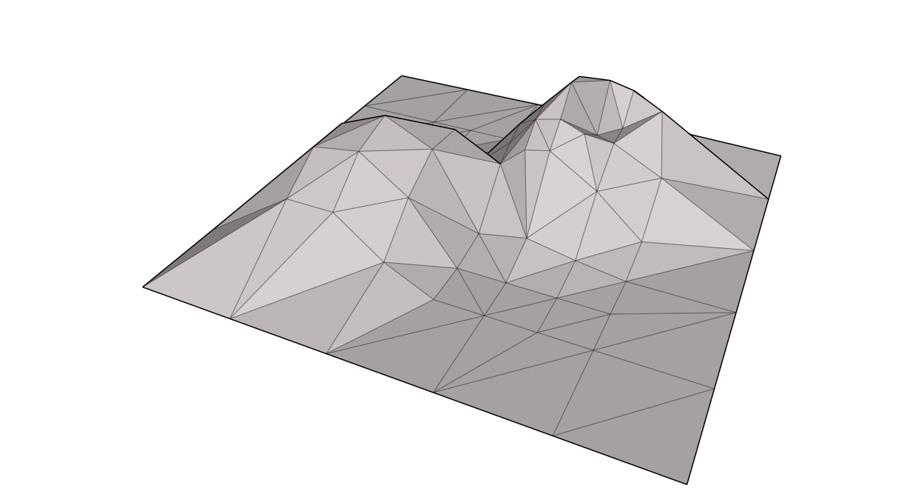
Big Terrain Data Analysis Algorithms in the Field Workshop SoCG June 19, 2012 Lars Arge

Slide 2
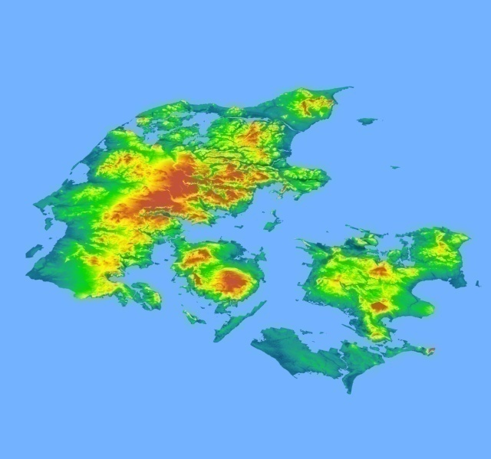
Outline of Talk
Big terrain data
I/O-efficient algorithms
I/O-efficient big terrain data algorithms
Surface water flow modeling
SCALGO

Slide 3
Big Terrain Data

Slide 4
Big Terrain Data
Shuttle Radar Topography Mission (SRTM):
11 day mission in 2000
Interferometric Synthetic Aperture Radar (IFSAR)
Near global dataset (60○N - 53○S)
3-arc seconds (90-meter at equator) raster
~60 billion cells in roughly 14.000 files (tiles)

Slide 5
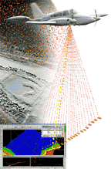
Big and Detailed Terrain Data
LiDAR delivers detailed and accurate data
Denmark (~42.000 km²):
Previously: Typically 30 meter resolution
~46 million points (<1GB)
Now: LiDAR data of 1,6 meter resolution
~26 billion points (>1TB)
NC ~136.000 km²
US ~ 9.600.000 km²

Slide 6
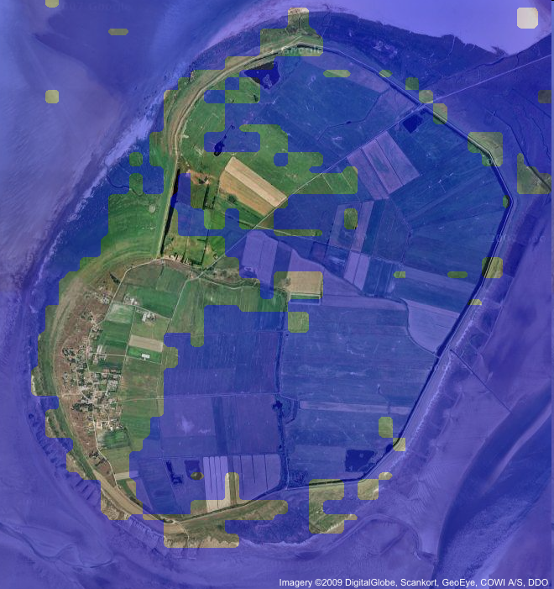
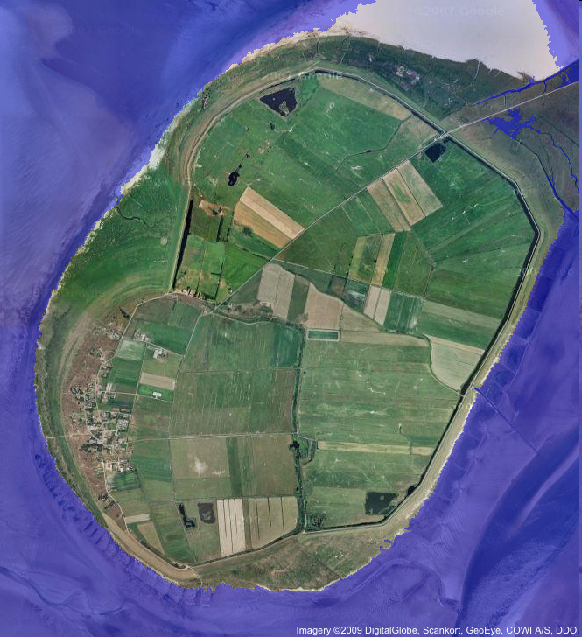
Detailed Terrain Data Essential
Sea-level rise (2 meter effect on Mandø)
90 meter terrain model
1,6 meter terrain model

Slide 7
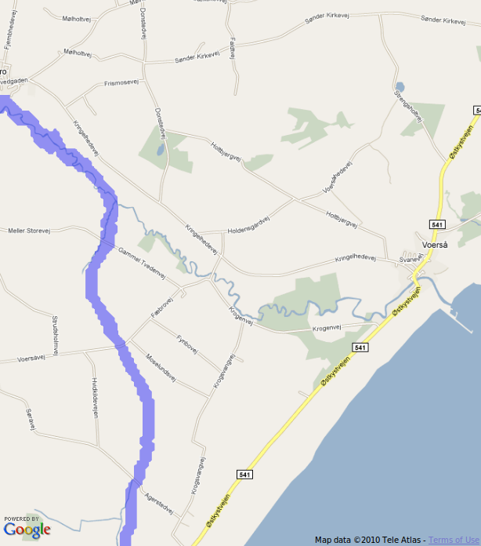
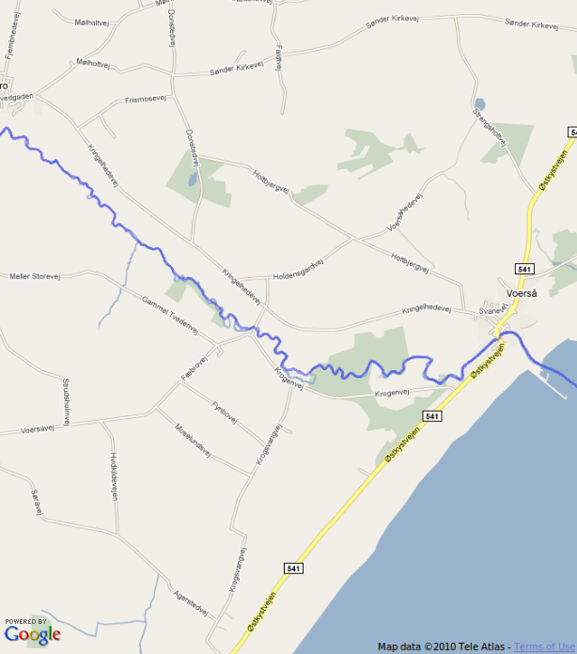
Detailed Terrain Data Essential
Drainage network (flow accumulation)
90 meter terrain model
1,6 meter terrain model

Slide 8
Massive Terrain Data Hard to Handle
Most commercial systems cannot handle truly massive datasets
and certainly not all of Denmark at 1,6-meter resolution
Typical workarounds
Tiling: Break terrain into pieces processed individually
Not really possible for flow computations
Leads to cumbersome workflows
Simplification: Reduce data size
Leads to unreliable results

Slide 9
I/O-Efficient Algorithms

Slide 10
I/O-Efficient Algorithms
I/O is often bottleneck when handling massive datasets
Disk access is 10⁶ times slower than main memory access!
Disk systems try to amortize large access time transferring large contiguous blocks of data
I/O-efficient algorithms: Store and access data to use blocks!
Normal algorithm
read/write head
track
read/write arm
running time
I/O-efficient algorithm
Main memory size
“The difference in speed between modern CPU and disk technologies is analogous to the difference in speed in sharpening a pencil using a sharpener on one’s desk or by taking an airplane to the other side of the world and using a sharpener on someone else’s desk.” (D. Comer)
magnetic surface
data size

Slide 11
I/O-model of Computation
Model parameters [AV88]
N= # of items in the problem instance
B = # of items per disk block
M = # of items that fit in main memory
Goal: Minimize I/O
Move of B consecutive elements between memory and disk
D
Block I/O
B
M
P

Slide 12
I/O-Efficient Algorithms Matter
Example: Traversing linked list (List ranking)
Array size N = 10 elements
Disk block size B = 2 elements
Main memory size M = 4 elements (2 blocks)
Difference between N and N/B large since block size is large
Example: N = 256 x 10⁶, B = 8000 , 1ms disk access time
⇒ N I/Os take 256 x 10³ sec = 4266 min = 71 hr
⇒ N/B I/Os take 256/8 sec = 32 sec
1
5
2
6
3
8
9
4
7
10
1
2
10
9
5
6
3
4
8
7
Algorithm 1: N=10 I/Os
Algorithm 2: N/B=5 I/Os

Slide 13
I/O-model of Computation
Scanning: O(N/B)
Sorting: O(Sort(N))=
Searching: O(log_{B} N)
Note: Not sort optimally with search tree
Priority queue: O(Sort(N)/N) amortized
Many O(Sort(N)) computational geometry results
Many graph algorithms results
D
Block I/O
B
M
P
Surveys [A02,V06]

Slide 14
External Plane Sweeping
Plane sweeping powerful technique for solving geometric problems
Example: Orthogonal line segment intersection
Sweep line top-down while maintaining search tree T on vertical segments crossing sweep line (by x-coordinates)
Top endpoint of vertical segment: Insert in T
Bottom endpoint of vertical segment: Delete from T
Horizontal segment: Perform range query with x-interval on T

Slide 15
External Plane Sweeping
Plane sweeping powerful technique for solving geometric problems
Example: Orthogonal line segment intersection
In internal memory algorithm runs in optimal O(N log N+T) time
In external memory algorithm performs badly (>N I/Os) if |T|>M
Even if we implements T as B-tree ⇒ O(N log_{B} N+T/B) I/Os

Slide 16
Distribution Sweeping
Divide plane into M/B slabs with N/(M/B) endpoints each
Sweep plane top-down while reporting intersections between
Vertical and part of horizontal segments spanning slab(s)
Distribute data to M/B slabs
Vertical and non-spanning parts of horizontal segments
Recurse in each slab

Slide 17
Distribution Sweeping
Sweep performed in O(N/B+T’/B) I/Os ⇒ I/Os
Maintain active list of vertical segments for each slab (<B in MM)
Top endpoint of vertical segment: Insert in active list
Horizontal segment: Scan through all relevant active lists
Removing “expired” vertical segments
Reporting intersections with “non-expired” vertical segments

Slide 18
(Some) I/O-Efficient Big Terrain Data Algorithms

Slide 19
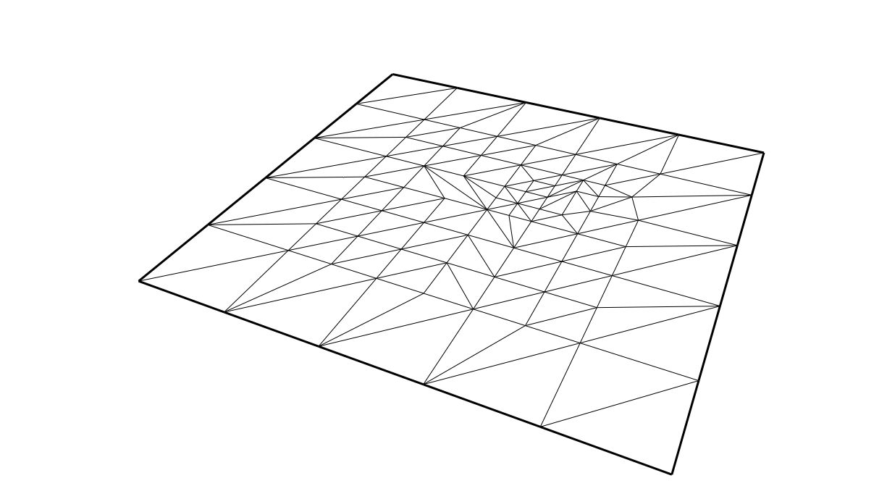
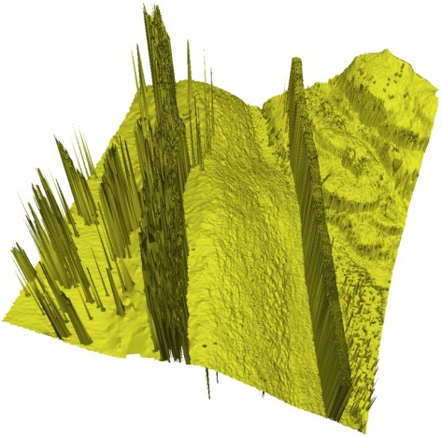
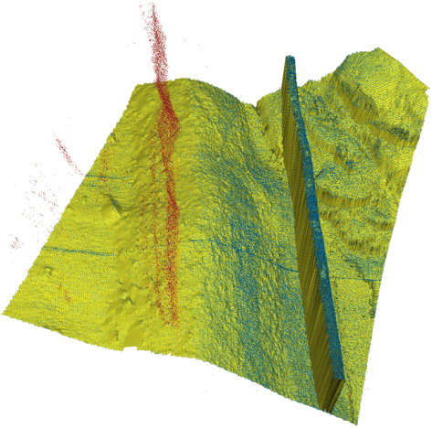
I/O-model Terrain Results
Model construction
O(Sort(N)) Triangular irregular network (TIN):
Build planar triangulation on input points and lift to 3d
Delaunay triangulation [GTVV93]
Constrained Delaunay triangulation [AAY05]
O(Sort(N)) Raster (Grid):
By Delaunay or spline interpolation [AAD06]
Point data cleaning
O(Sort(N)) removal of noise (outliers) in sonar data
Planar graph (Delaunay) connected components
Under some realistic assumptions

Slide 20
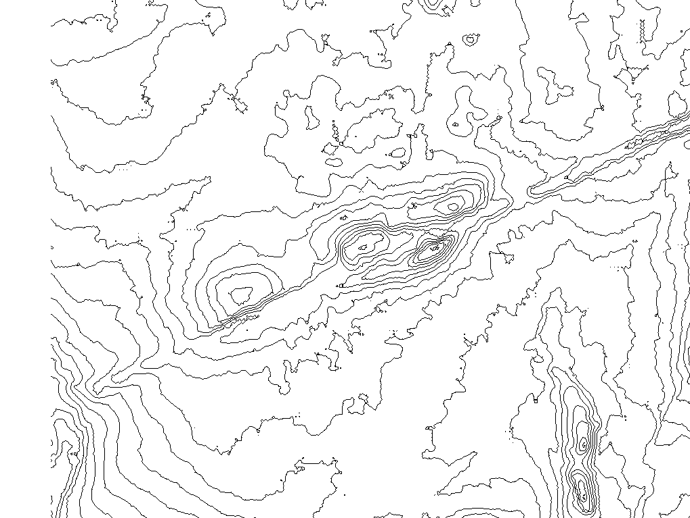
I/O-model Terrain Results
Contours from model (TIN/Raster)
Easy to construct contour segments in O(N/B+T/B)
Hard to order segments along individual contours
Tracing contours ⇒ O(T) I/Os
Sorting/List ranking contours ⇒ O(Sort(T))
O(Sort(N)+T/B)) ordered contour map and nesting info [AAMS08]
Order TIN triangles such that partial connected contours are nested like balanced parenthesis

Slide 21
I/O-model Terrain Results
Model Simplification
LiDAR ⇒ many “insignificant” depressions ⇒ e.g. ugly contours
Removal of insignificant depressions:
Score each depression (persistent homology)
Remove low score depressions by “flooding”
Sweep terrain: Depression Score = death – birth time
Minimum: Component is born
Saddle: Components merge;
later birth time component die
O(Sort(N)) simplification (persistent homology) [AAY06]
Using batched Union-Find solved using distribution sweeping
Insignificant
Significant

Slide 22
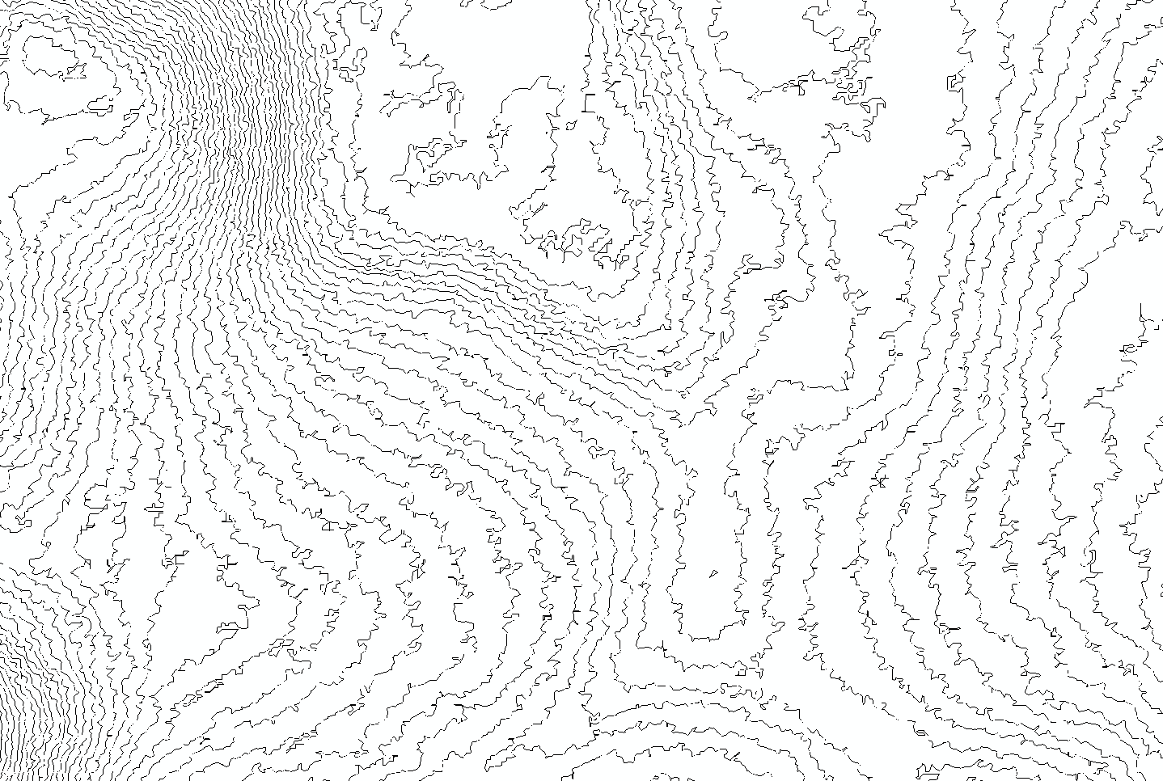
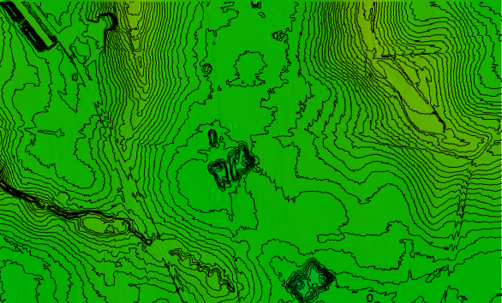
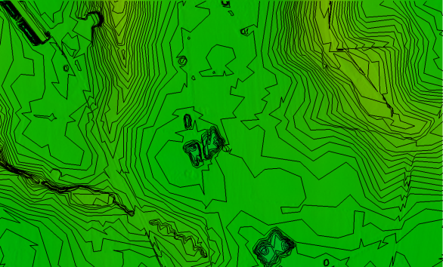
I/O-model Terrain Results
Contour simplification
Removal of insignificant depressions removes insignificant contours
But simplification of individual curves still needed
Simplifying individual contours (e.g.
Douglass-Peucker) may result in non-
homotopic and intersecting contours
Recently, O(Sort(T)) practical algorithm maintaining homotopy and guaranteeing non-intersecting contours [ADMRT12]
Under some realistic assumptions
Simplify model directly?
Open to do so I/O-efficiently!

Slide 23
Flood Modeling

Slide 24
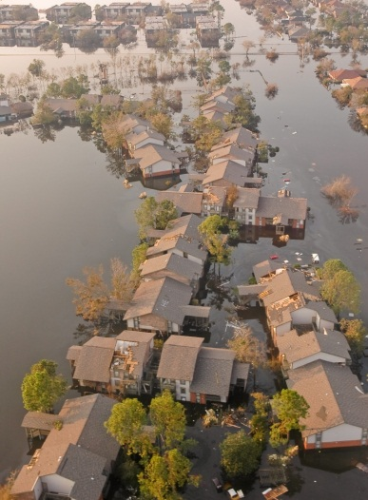
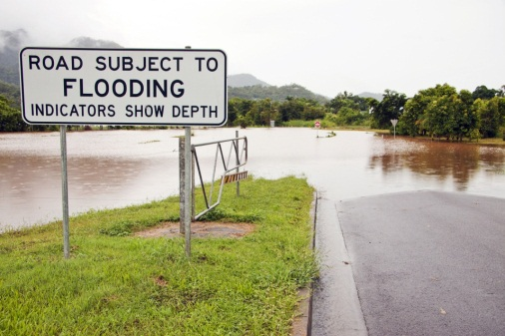
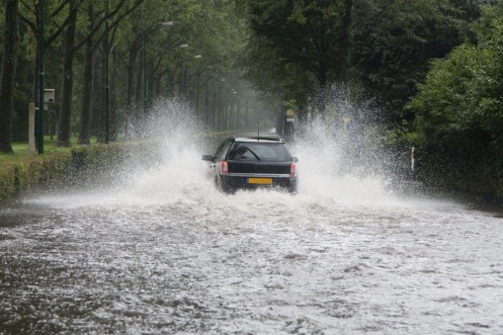
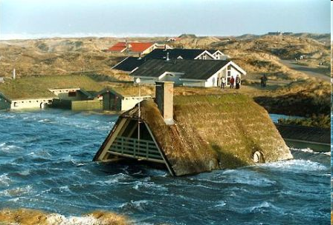
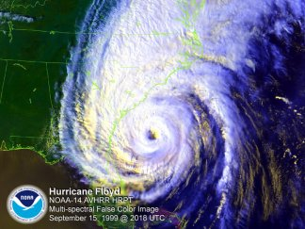
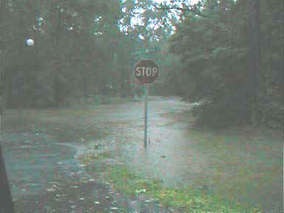
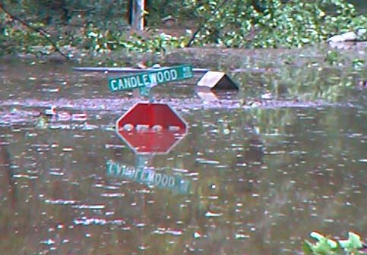
Flood Risk Analysis Important
Increasingly important to predict
areas susceptible to floods
Due to e.g extreme rain or rising sea-level
Hurricane Floyd Sep. 15, 1999
7 am 3pm

Slide 25
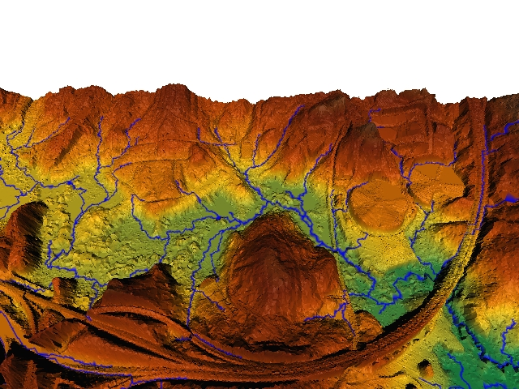
Basic Raster Terrain Flow Modeling
Rising sea-level: Sea-level mapping
The minimal sea-level height each cell is flooded
Extreme rain: Surface water flow
Flow direction: The direction water flows at each cell
Flow accumulation: Amount of water flowing through each cell
Flow accumulation of cell = size of “upstream area”
Drainage network = cells with high flow accumulation

Slide 26
Detailed Terrain Data Essential
Sea-level rise (2 meter effect on Mandø)
90 meter terrain model
1,6 meter terrain model

Slide 27
Detailed Terrain Data Essential
Drainage network (flow accumulation)
90 meter terrain model
1,6 meter terrain model

Slide 28
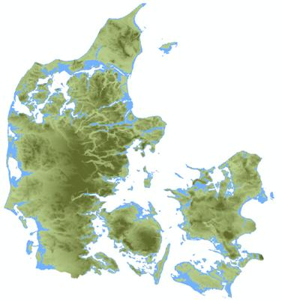
Rising Sea-Level
The minimal sea-level height each cell is flooded
New grid where terrain below h is flooded when water rise to h
No commercial software seemed to be able to
process all of Denmark at 1,6-meter resolution
I/O-efficient algorithm:
Result is simply simplification with
score threshold ∞ [AKY06]
⇓
Denmark in a day on standard 4GB desktop!

Slide 29
Flow Accumulation
Initially one unit of water in each grid cell
Water (initial and received) distributed from each cell to lowest lower neighbor cell (if existing)
Flow accumulation of cell is total flow through it

Slide 30
Flow Accumulation Algorithm
Sweep cells in decreasing height order. At each cell:
Flow from flow grid and neighbor heights from height grid
Update flow (flow grid) for downslope neighbors
Problem:
Cells of same height distributed over the terrain
⇒ Scattered access to flow grid and height grid
⇒ Ω(N) I/Os
Natural to try “tiling”: But different tiles not independent!
Performance of commercial systems are often unpredictable
And cannot handle Denmark at 1,6-meter resolution

Slide 31
I/O-Efficient Flow Accumulation
Eliminating height grid scattered accesses:
Augment each cell with height of 8 neighbors
Eliminating flow grid scattered accesses:
Note: Flow to neighbor only needed when reaching its elevation
Distribute flow by inserting element in priority queue
Priority equal to neighbor’s height (and grid position)
Flow of cell obtained using DeleteMin operations
⇒ Turns O(N) grid accesses into O(N) priority queue operations
⇒ O(Sort(N)) algorithm [ACHTUVW03]
⇓
Denmark 1,6-meter model in two days on standard 4GB desktop!
Really “Time-forward processing” technique [CGGTVV95]

Slide 32
Flash Flood Mapping
Models how surface water gathers in depressions as it rains
Water from watershed of depression gathers in the depression
Depressions fill, leading to (potentially dramatic) increase in neighbor depression watershed size
Flash Flood Mapping:
Amount of rain before any given raster cell is below water
Watershed area
Watershed area
Volume
Volume

Slide 33
Flash Flood Mapping
Relatively easily solved in O(N log N) internal memory time [LS05]
Using priority queue and Union-Find structure
Algorithm runs in O(N (N))+Sort(N)) I/Os since no I/O-efficient online union-find structure known
Recently solved in O(Sort(N) log (N/M)) I/Os [ARZ10]
e.g. using time-forward processing and batched Union-Find
$$α$$
Watershed area
Volume

Slide 34
SCALGO

Slide 35
SCALGO
Established in 2009 to commercialize I/O-efficient terrain processing technology
Founders:
Lars Arge
Pankaj Agarwal
Morten Revsbæk
Thomas Mølhave

Slide 36
SCALGO Products
Embedded
Software Packages
Computation Services
SCALGO S-CAN
SCALGO Model
SCALGO Hydrology
SCALGO Simplify
SCALGO Flash Flood Mapping
SCALGO Contour Maps
SCALGO
I/O-Efficient
Technology

Slide 37
SCALGO Software Products
Embedded software:
SCALGO S-CAN for terrain (sonar) data cleaning within EIVA NaviModel product
Software packages:
SCALGO Model constructs and simplifies massive
terrain models
SCALGO Hydrology performs basic hydrological
analysis on massive raster terrain models
SCALGO Simplify adds massive raster terrain model
simplification functionality to SCALGO Hydrology

Slide 38
SCALGO Model Success Stories
LiDAR scan of Denmark (42.000 km²)
Whole country
26 billion points in roughly 14,000 files
On standard workstation with 4GB memory
National 2-meter 26 billon cell raster model in 2 days
Without thinning or tiling
Simplification of 26 billon cell raster model full model in ½ day

Slide 39
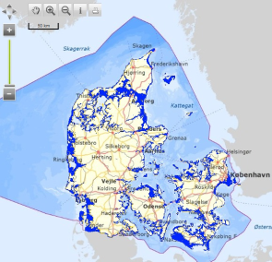
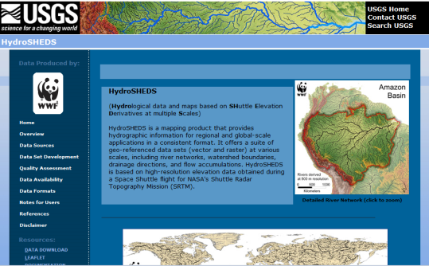
SCALGO Hydrology Success Stories
Sea-level rise:
National sea-level rise tool launched on
Danish Ministry of the Environment climate
change portal (klimaportalen.dk)
One weekend hits = normal 6 months
Flow accumulation:
Shuttle Radar Topography Mission (SRTM):
90-meter near global grid (~60G cells)
Large USGS Hydrosheds project produced
“hydrological conditioned” grid
But upscaled to 500-meter to compute flow accumulation
SCALGO flow accumulation in 1½ day on standard workstation

Slide 40
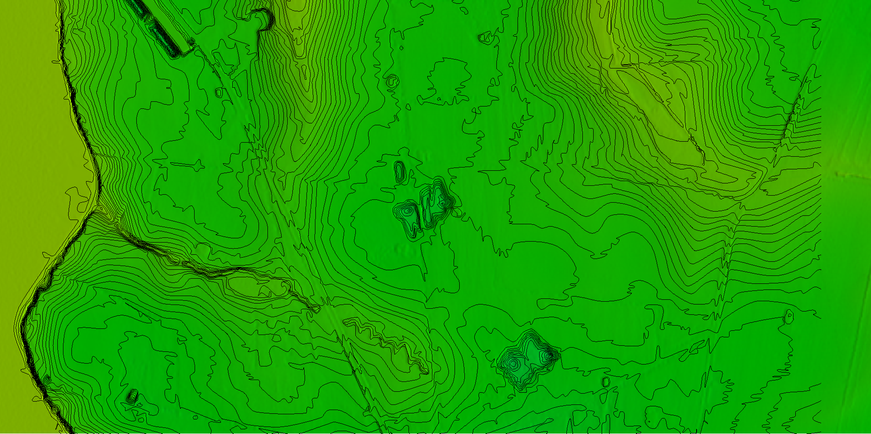
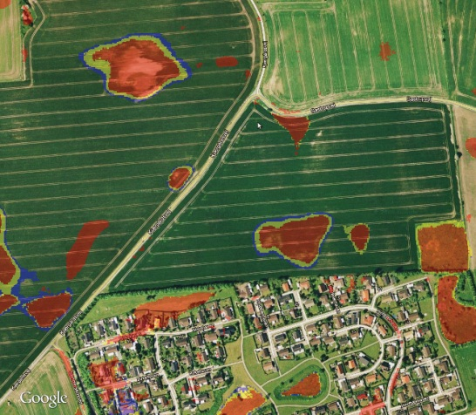
SCALGO Computation Services
SCALGO performs computation consulting work:
On big terrains using SCALGO Model and SCALGO Hydrology
Using advanced in-house tool, such as tools for
Production of realistic contours
Flash Flood Mapping

Slide 41
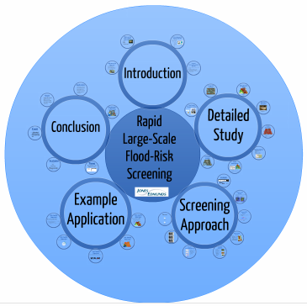
Flash Flood Mapping Success Stories
The major European (Danish) engineering consulting company COWI has launched product in Denmark (”Skybrudskort®“)
Sold to over 10 local government and
one of 5 regions (13.000 km²)
Now being produced for entire country
The major Florida engineering consulting company Jones Edmunds recently compared Flash Flood Mapping to result of advanced dynamic model (ICPR) for Marion County, Florida
Results very close
Significantly more detailed
Cost under 5% (significantly
reduced production time)

Slide 42
Demo
Demo
Sea-level rise, flow accumulation and Flash Flood Mapping
Computed I/O-efficient using SCALGO Software
On 1,6-meter resolution Denmark raster (~26 Billion cells)
Build from LiDAR 26 Billion LiDAR points in its entirety
On 90-meter resolution near global raster (~60 Billion cells)

Slide 43
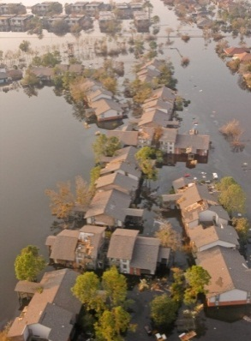
Summary/Conclusion
Big terrain data available, essential and hard to handle
I/O often bottleneck when handling big terrain data
I/O-efficient algorithms
Many terrain data algorithms developed based on CG technology
⇒ solutions to important practical problems
Technology commercialized by SCALGO
Open problem examples:
Model simplification
Dynamic flow models
Incorporation of further data (soil type, ground
water, infrastructure, …) in flow models

